Slide 1

Quantifying the Breadth of Vaccine Responses
Amanda Skarlupka
2/8/2022

Slide 2
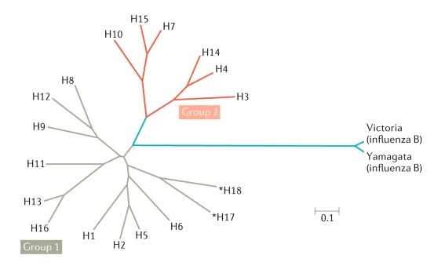
Next Generation of Influenza Vaccines
Vaccine | Breadth
Strain-specific | Current Circulating Strain
Subtype-specific | Multiple strains within a subtype (H1 or H3)
Group-specific | Multiple subtypes within a group
Pan-group | Entire Group
Universal Flu A | All Influenza A
Universal Flu | All influenza A and B
Wei, CJ., Crank, M.C., Shiver, J. et al. Next-generation influenza vaccines: opportunities and challenges. Nat Rev Drug Discov 19, 239–252 (2020). https://doi.org/10.1038/s41573-019-0056-x

Slide 3
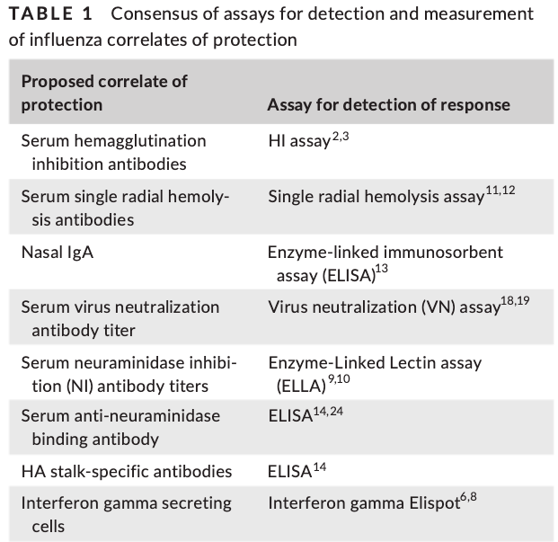
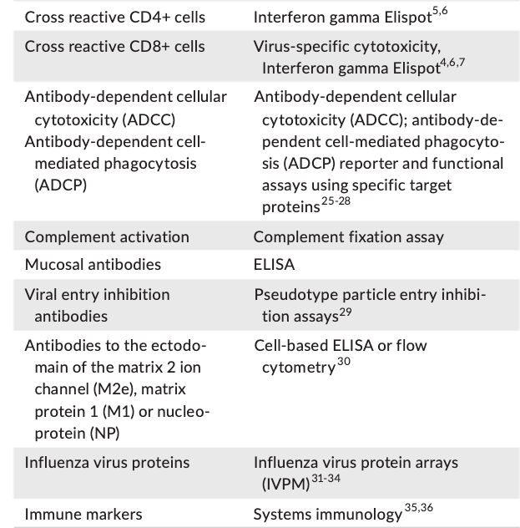
Efficacy of Vaccine Candidates
Challenge results
Animal model directly infected with virus
Survival, weight loss, clinical scores, viral load
Magnitude of antibody response
Viral breadth of antibody response
Functionality of the antibody response
Krammer F, Weir JP, Engelhardt O, Katz JM, Cox RJ. Meeting report and review: Immunological assays and correlates of protection for next-generation influenza vaccines. Influenza Other Respir Viruses. 2020 Mar;14(2):237-243. doi: 10.1111/irv.12706. Epub 2019 Dec 13. PMID: 31837101; PMCID: PMC7040967.

Slide 4
Viral Breadth Determination
Conduct the correlate of protection assay against:
Homologous virus
Heterologous viruses
Compare results
How to compare the results from between different vaccine candidates to choose the one with the broadest breadth and sufficient magnitude of response?
How to start quantifying breadth?

Slide 5
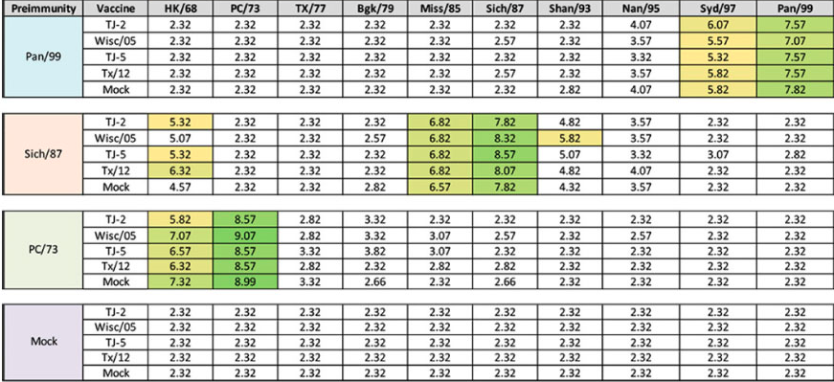
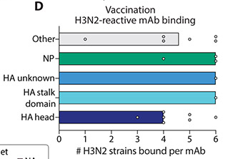
Count the Strains
HAI results of preimmune vaccine sera tested against H3N2 virus panel
Researcher chooses the breadth panel
May not be the same strains chosen by other groups
Depends on the strains chosen
Usually selected from previously determined “antigenic clusters” or genetic clades
Open to bias
Selection bias
Availability (recent vs older strains)
Dugan, H. L., Guthmiller, J. J., Arevalo, P., Huang, M., Chen, Y. Q., Neu, K. E., Henry, C., Zheng, N. Y., Lan, L. Y., Tepora, M. E., Stovicek, O., Bitar, D., Palm, A. E., Stamper, C. T., Changrob, S., Utset, H. A., Coughlan, L., Krammer, F., Cobey, S., & Wilson, P. C. (2020). Preexisting immunity shapes distinct antibody landscapes after influenza virus infection and vaccination in humans. Science translational medicine, 12(573), eabd3601. https://doi.org/10.1126/scitranslmed.abd3601
Allen, 2021. Evaluation of Next-Generation H3 Influenza Vaccines in Ferrets Pre-Immune to Historical H3N2 Viruses. 10.3389/fimmu.2021.707339

Slide 6
How to quantify the differences between strains?
Year of isolation
Not representative of antigenic relatedness
Glycosylation/mutations and Antigenic shifts
Genetic differences
Genetic cluster do not always match antigenic clusters
Methods are becoming more refined
Antigenic cartography
Multidimensional scaling analysis of antibody responses to a distance value

Slide 7
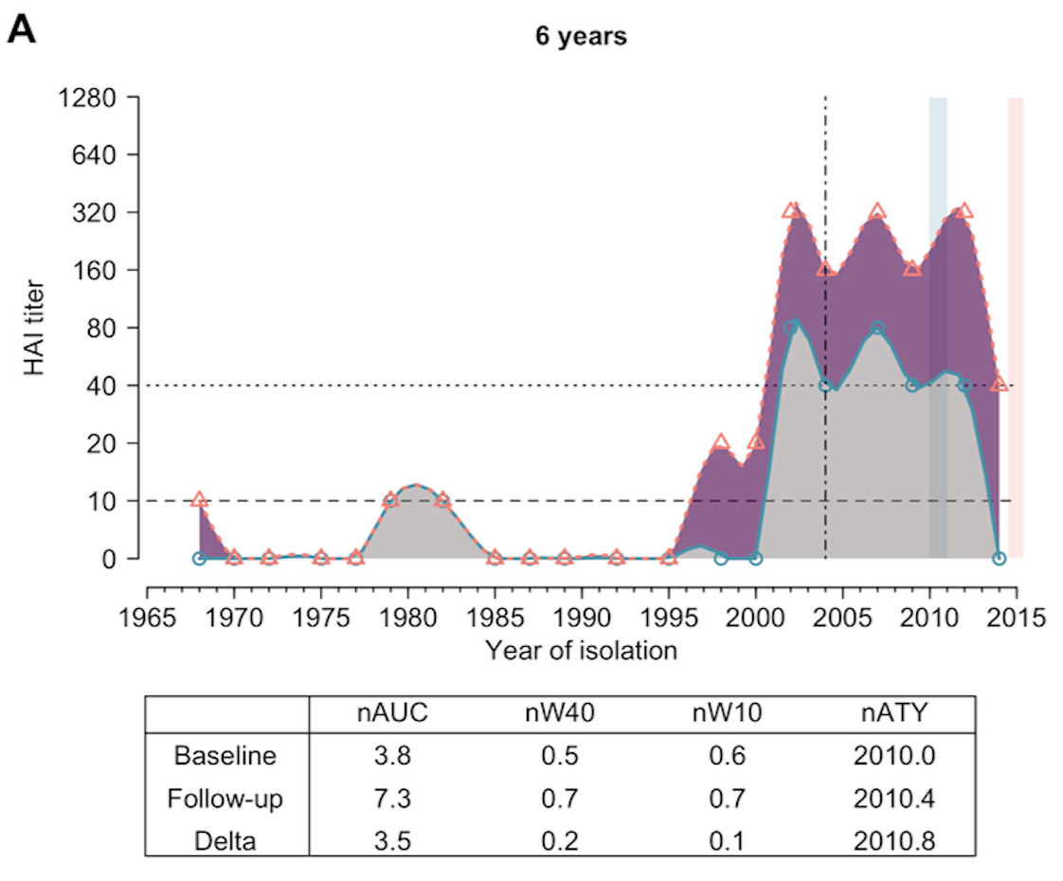
Year of Isolation
Virus’ year of isolation
Relative to beginning of pandemic era or relative to a certain vaccine strain
Bris/07 to CA/09
2 year pairwise distance
Does not account for changes in:
Rate of antigenic drift
Antigenic shifts
Hinojosa M, Shepard SS, Chung JR, et al. Impact of Immune Priming, Vaccination, and Infection on Influenza A(H3N2) Antibody Landscapes in Children. J Infect Dis. 2021;224(3):469-480. doi:10.1093/infdis/jiaa665
Yang B, Lessler J, Zhu H, Jiang CQ, Read JM, Hay JA, et al. (2020) Life course exposures continually shape antibody profiles and risk of seroconversion to influenza. PLoS Pathog 16(7): e1008635. https://doi.org/10.1371/journal.ppat.1008635

Slide 8
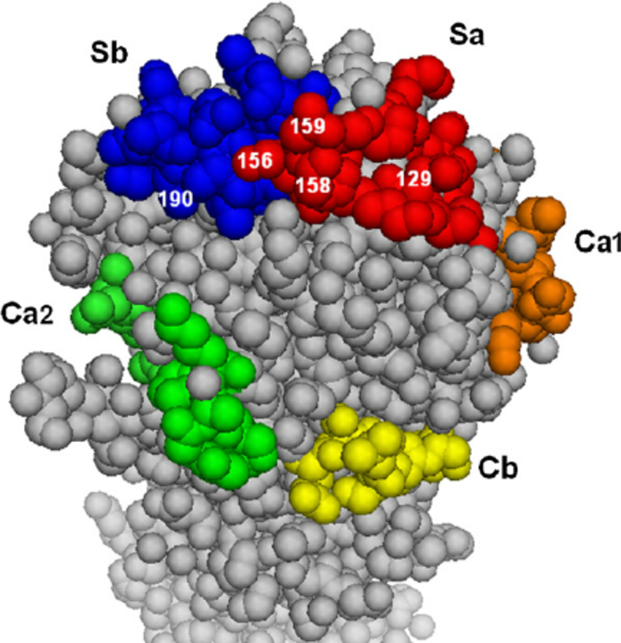
Genetic Differences
Distance value incorporates genetic information
P-Epitope includes information specifically related to the antigenic sites of the protein, not the full protein sequence
~5 antigenic sites
Determine the proportion of differences in each site (p-epitope)
Max proportion = p-dominant epitope value
Genetic clusters do not always match antigenic clusters
1 Amino acid residue mutation can shift the antigenic recognition

Slide 9
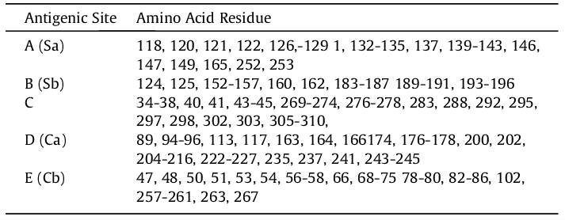
Genetic Differences
Distance value incorporates genetic information
P-Epitope includes information specifically related to the antigenic sites of the protein, not the full protein sequence
~5 antigenic sites
Determine the proportion of differences in each site (p-epitope)
Max proportion = p-dominant epitope value
Genetic clusters do not always match antigenic clusters
1 Amino acid residue mutation can shift the antigenic recognition

Slide 10
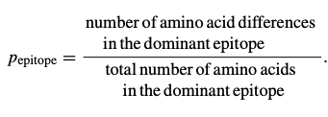
Genetic Differences
Distance value incorporates genetic information
P-Epitope includes information specifically related to the antigenic sites of the protein, not the full protein sequence
~5 antigenic sites
Determine the proportion of differences in each site (p-epitope)
Max proportion = p-dominant epitope value
Genetic clusters do not always match antigenic clusters
1 Amino acid residue mutation can shift the antigenic recognition

Slide 11
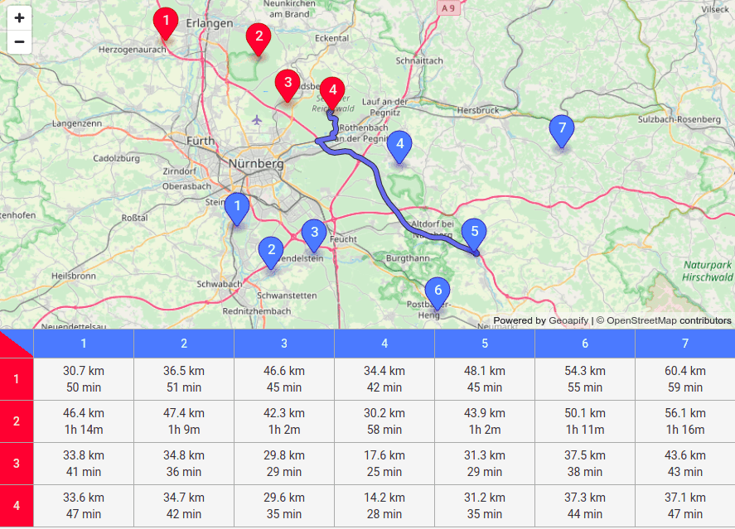
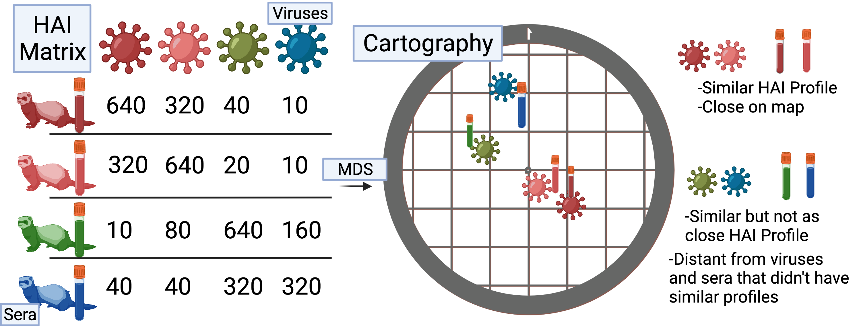
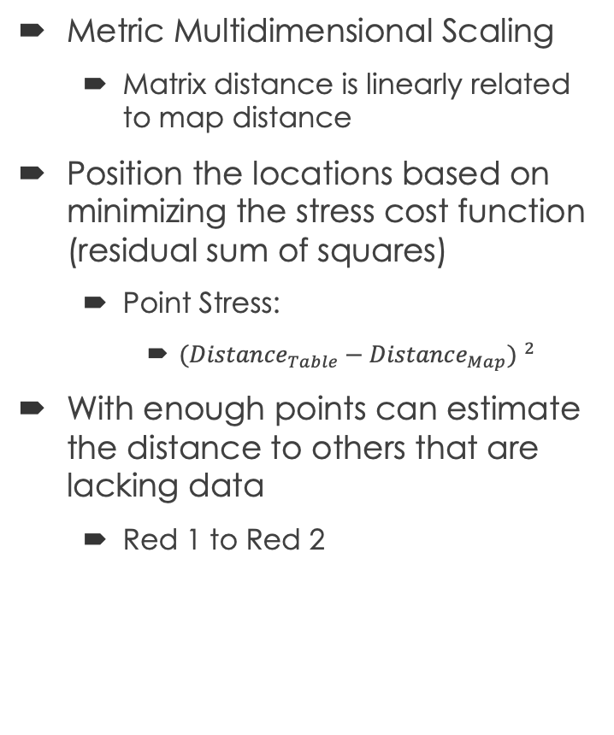
Antigenic Cartography
~10 km
Metric Multidimensional Scaling
Matrix distance is linearly related to map distance
Position the locations based on minimizing the stress cost function (residual sum of squares)
Point Stress:
${({Distance}_{Table}−{Distance}_{Map}) }^{2}$
With enough points can estimate the distance to others that are lacking data
Red 1 to Red 2
From the experimental antibody data (HAI titers) create a matrix of [sera x virus]
Grid lines are Antigenic distance units
1 unit = 1 2-fold change in HAI titer
Distances between viruses used as a measurement
30.7 km
Created with BioRender.com

Slide 12
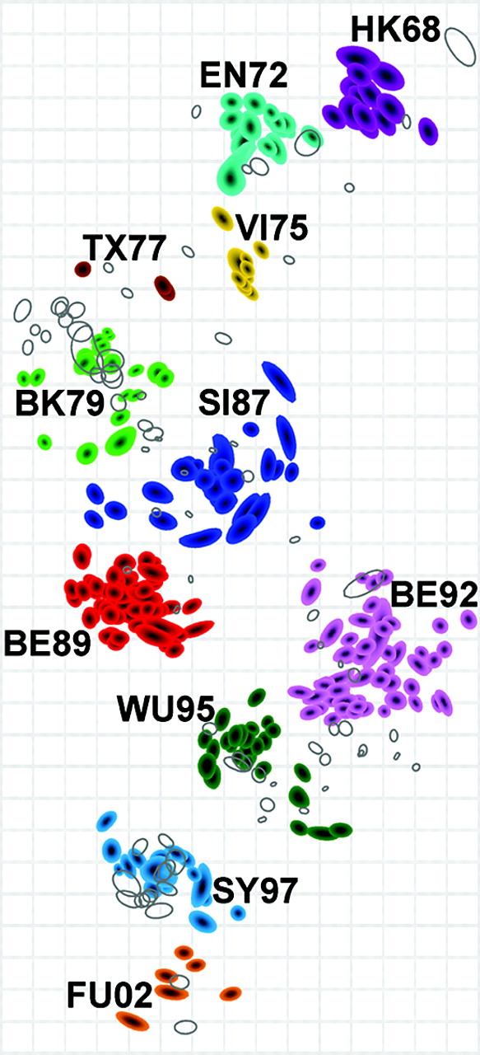
Antigenic Cartography
Smith DJ, Lapedes AS, de Jong JC, Bestebroer TM, Rimmelzwaan GF, Osterhaus AD, Fouchier RA. Mapping the antigenic and genetic evolution of influenza virus. Science. 2004 Jul 16;305(5682):371-6. doi: 10.1126/science.1097211. Epub 2004 Jun 24. PMID: 15218094.
Distance matrix created from the experimental antibody data (HAI titers) to different viruses [sera x virus]
Grid lines are Antigenic distance units
1 unit = 1 2-fold change in HAI titer
Linear relationship between change Log2 HAI titer and distance on map
Distances between viruses used as a measurement
Antigenic
Drift
Over
Time
Created with BioRender.com

Slide 13
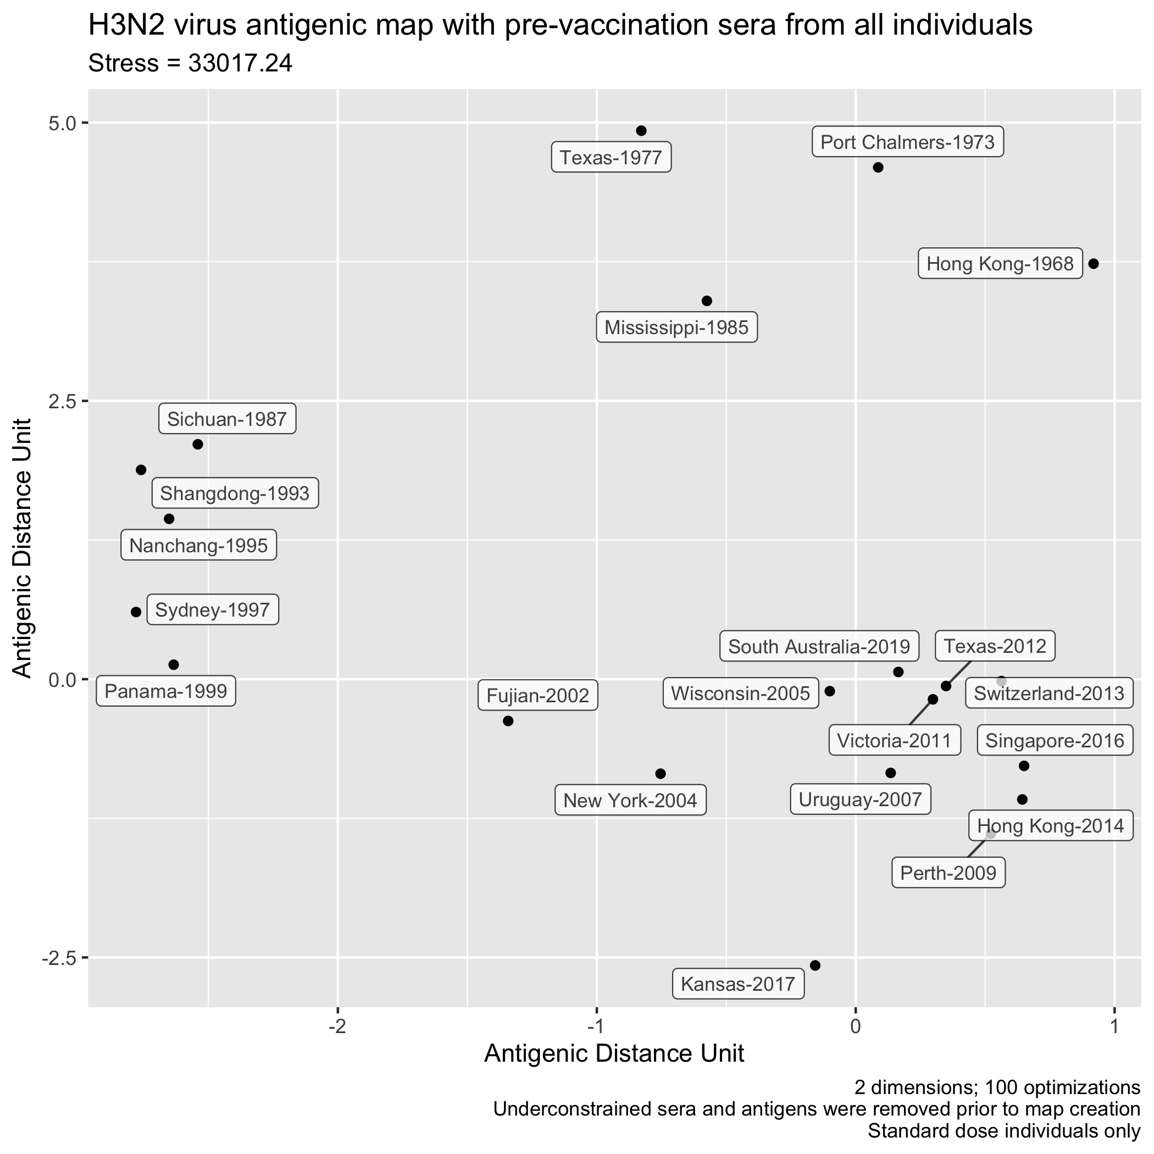
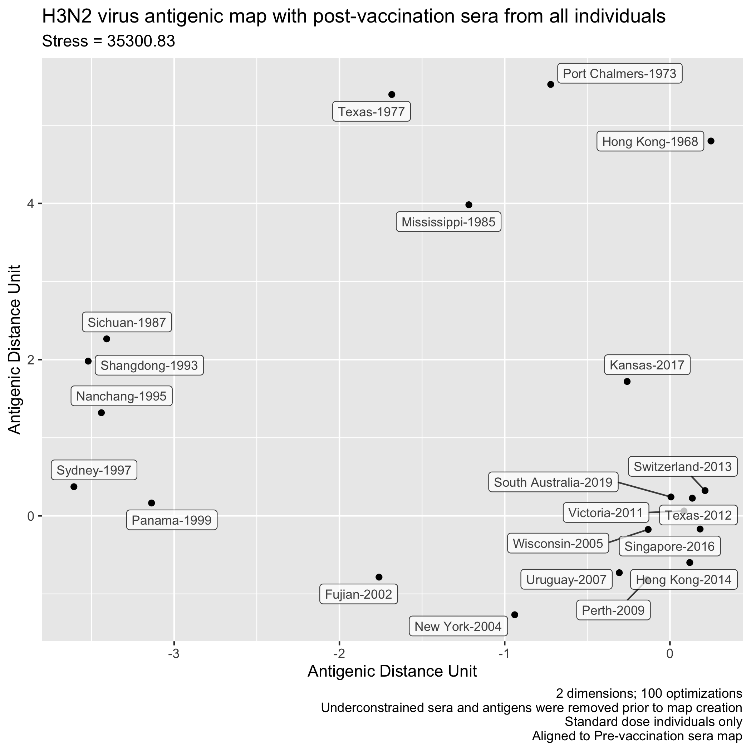
H3N2 Antigenic Maps with preimmune human sera

Slide 14
Relative Euclidean distances to vaccine strain

Slide 15
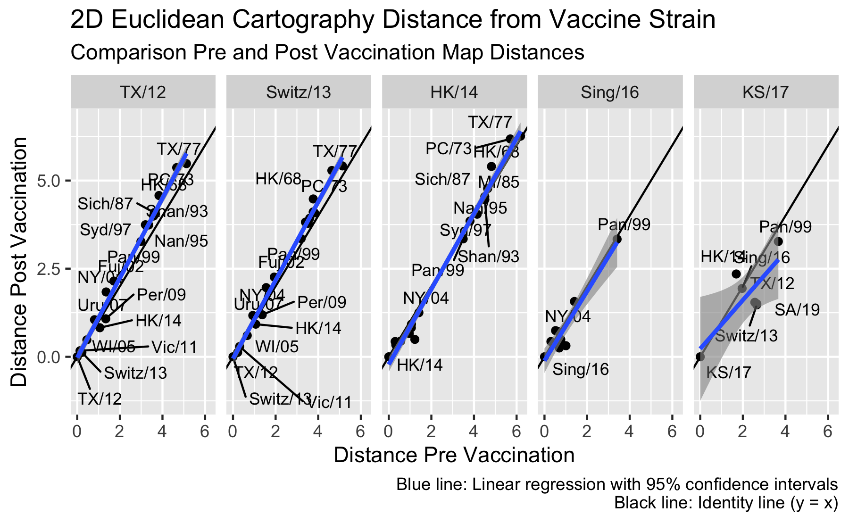
Comparison of relative distance to vaccine viruses pre and post vaccination
Relative antigenic distances with pre- and post-vaccination sera are similar
Different viruses are in the HAI panel during different seasons
Sing/16 and KS/17
Includes only up to Pan/99

Slide 16
Example of Different Measures for an Individual
Antigen | Prevac HAI | Postvac HAI | Increase | Year | Epitope | Cartography
TX/12* | 6 | 6 | 0 | 0 | 0 | 0
Pan/99 | 6 | 4 | -2 | 13 | 0.476 | 3.273
HK/68 | 0 | 0 | 0 | 44 | 0.714 | 4.575
*FL2014-1023; TX/12 Vaccine
Relative Distance: Distance from vaccine strain is 0
Each HAI titer for everyone can be plotted with x-axis: distance, y-axis: HAI result

Slide 17
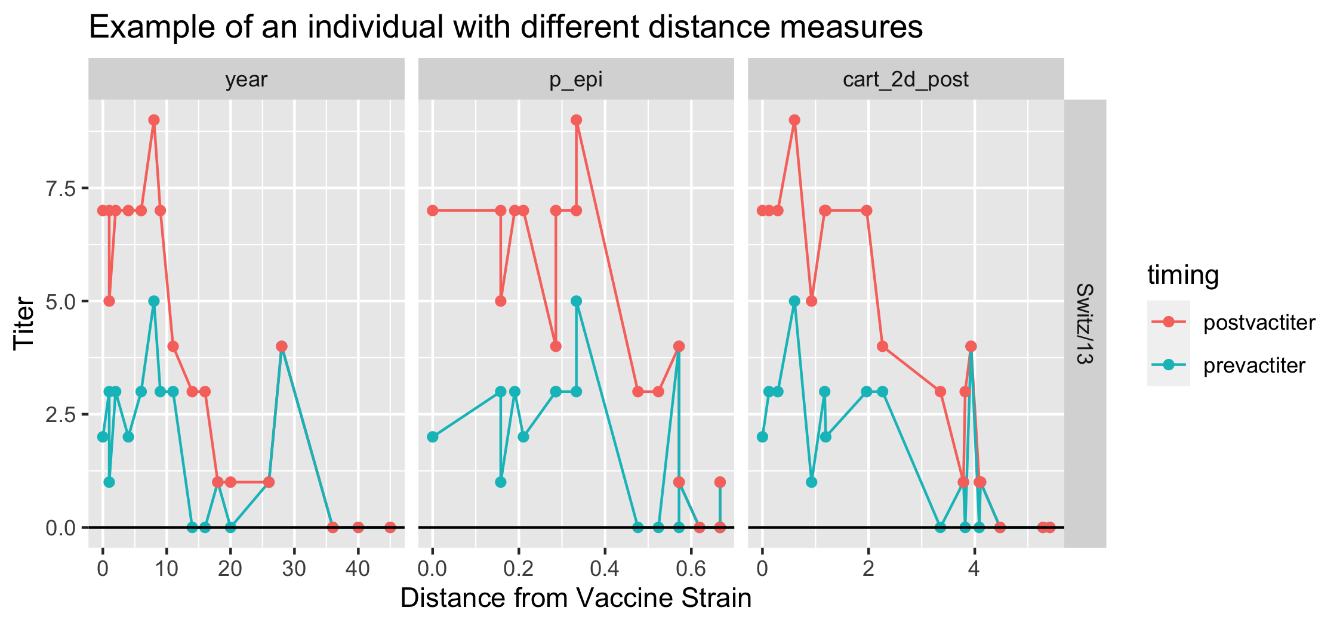
Visualization of Distances and Vaccine Response
WI/05; 6th
WI/05; ~9th
WI/05; 4th

Slide 18
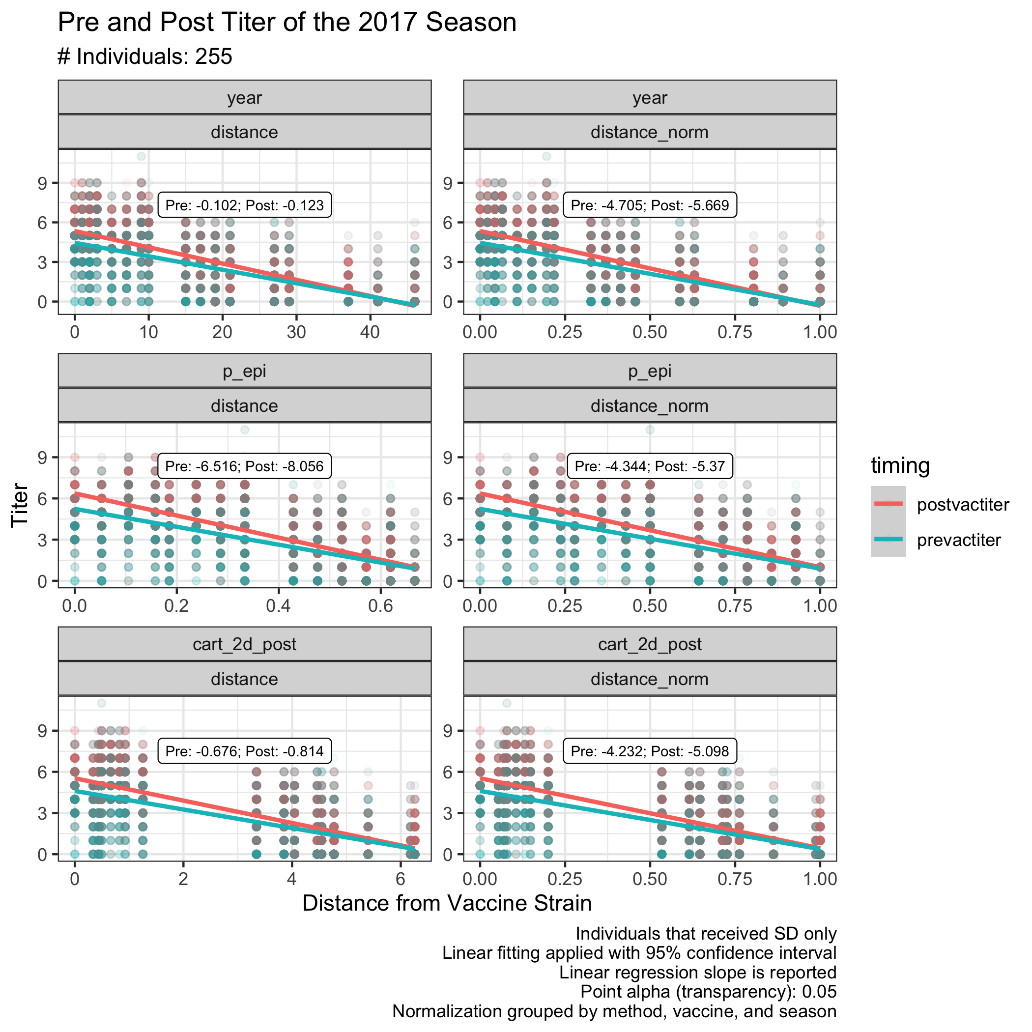
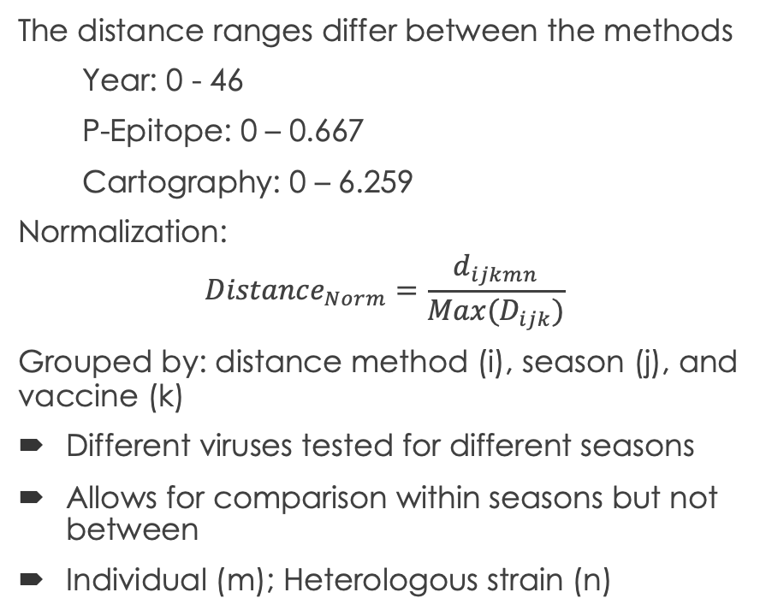
Normalization of Distances
The distance ranges differ between the methods
Year: 0 - 46
P-Epitope: 0 – 0.667
Cartography: 0 – 6.259
Normalization:
$${Distance}_{Norm}=\frac{d_{ijkmn}}{Max(D_{ijk})}$$
Grouped by: distance method (i), season (j), and vaccine (k)
Different viruses tested for different seasons
Allows for comparison within seasons but not between
Individual (m); Heterologous strain (n)
H3N2-Hong Kong-2014 Vaccine Strain

Slide 19
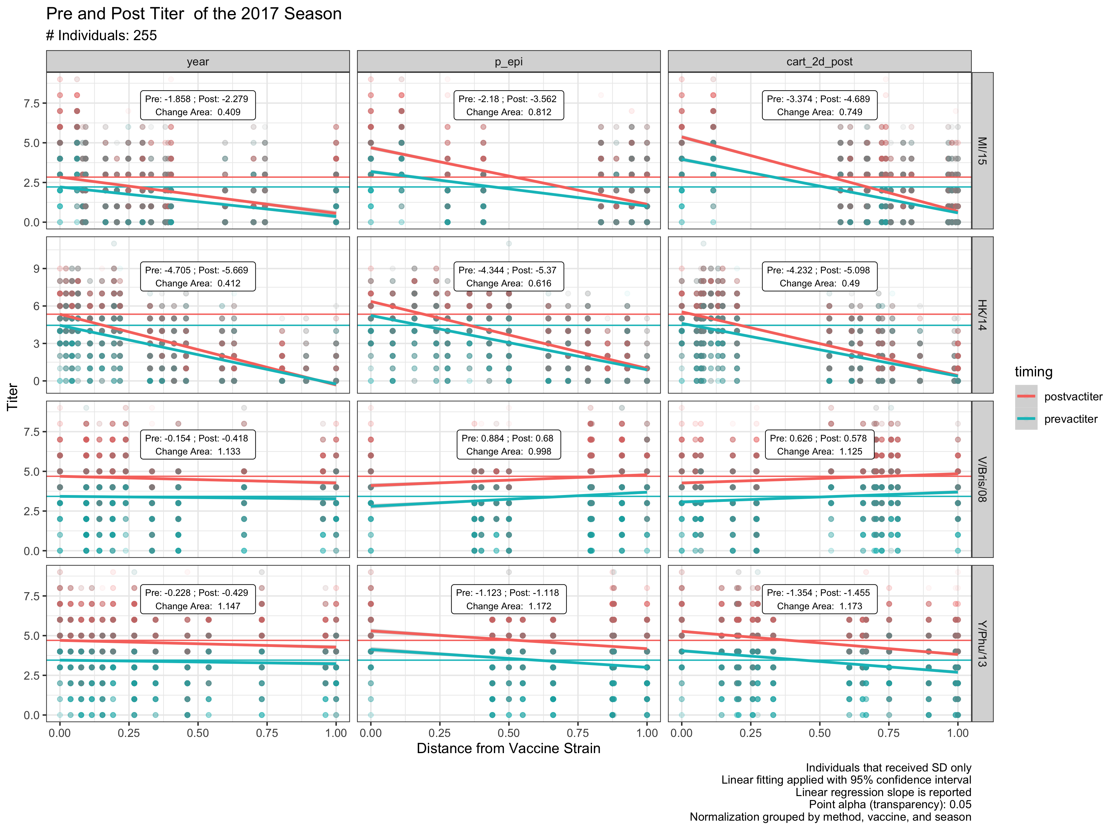
Comparison of Pre/Post Titer
H1N1:
P-epitope/Cartography
H3N2:
All three are similar
Antigenic drift is well correlated with time
Type B
All strains are shown for each subtype
Notes:
For the type B’s, when looking at only the matched and pre lineages, the trends are about the same. The opposite lineages are in the middle so the leverage of the points aren’t as strong

Slide 20
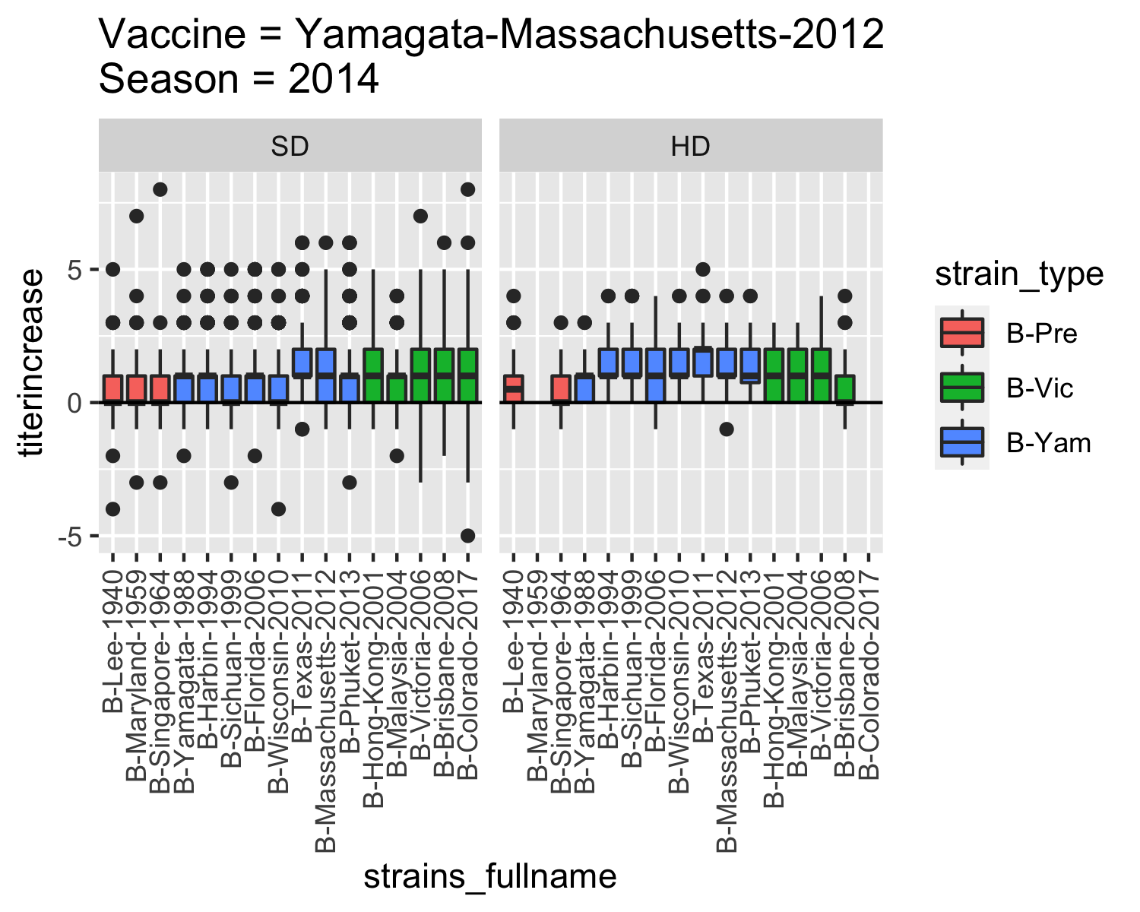
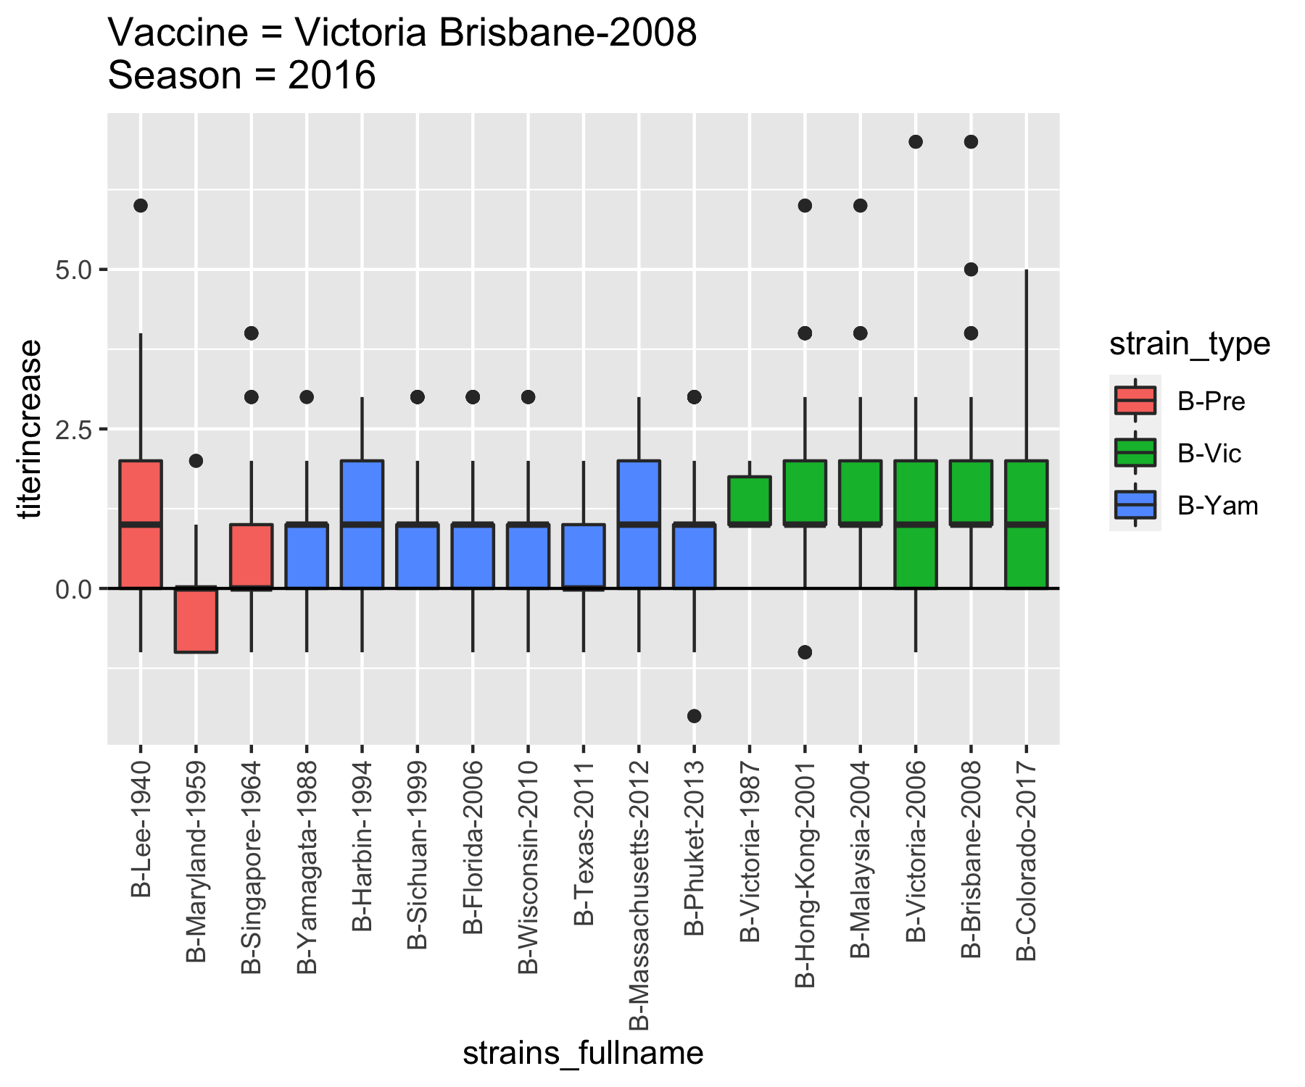
Single component vaccines elicit cross-lineage responses

Slide 21
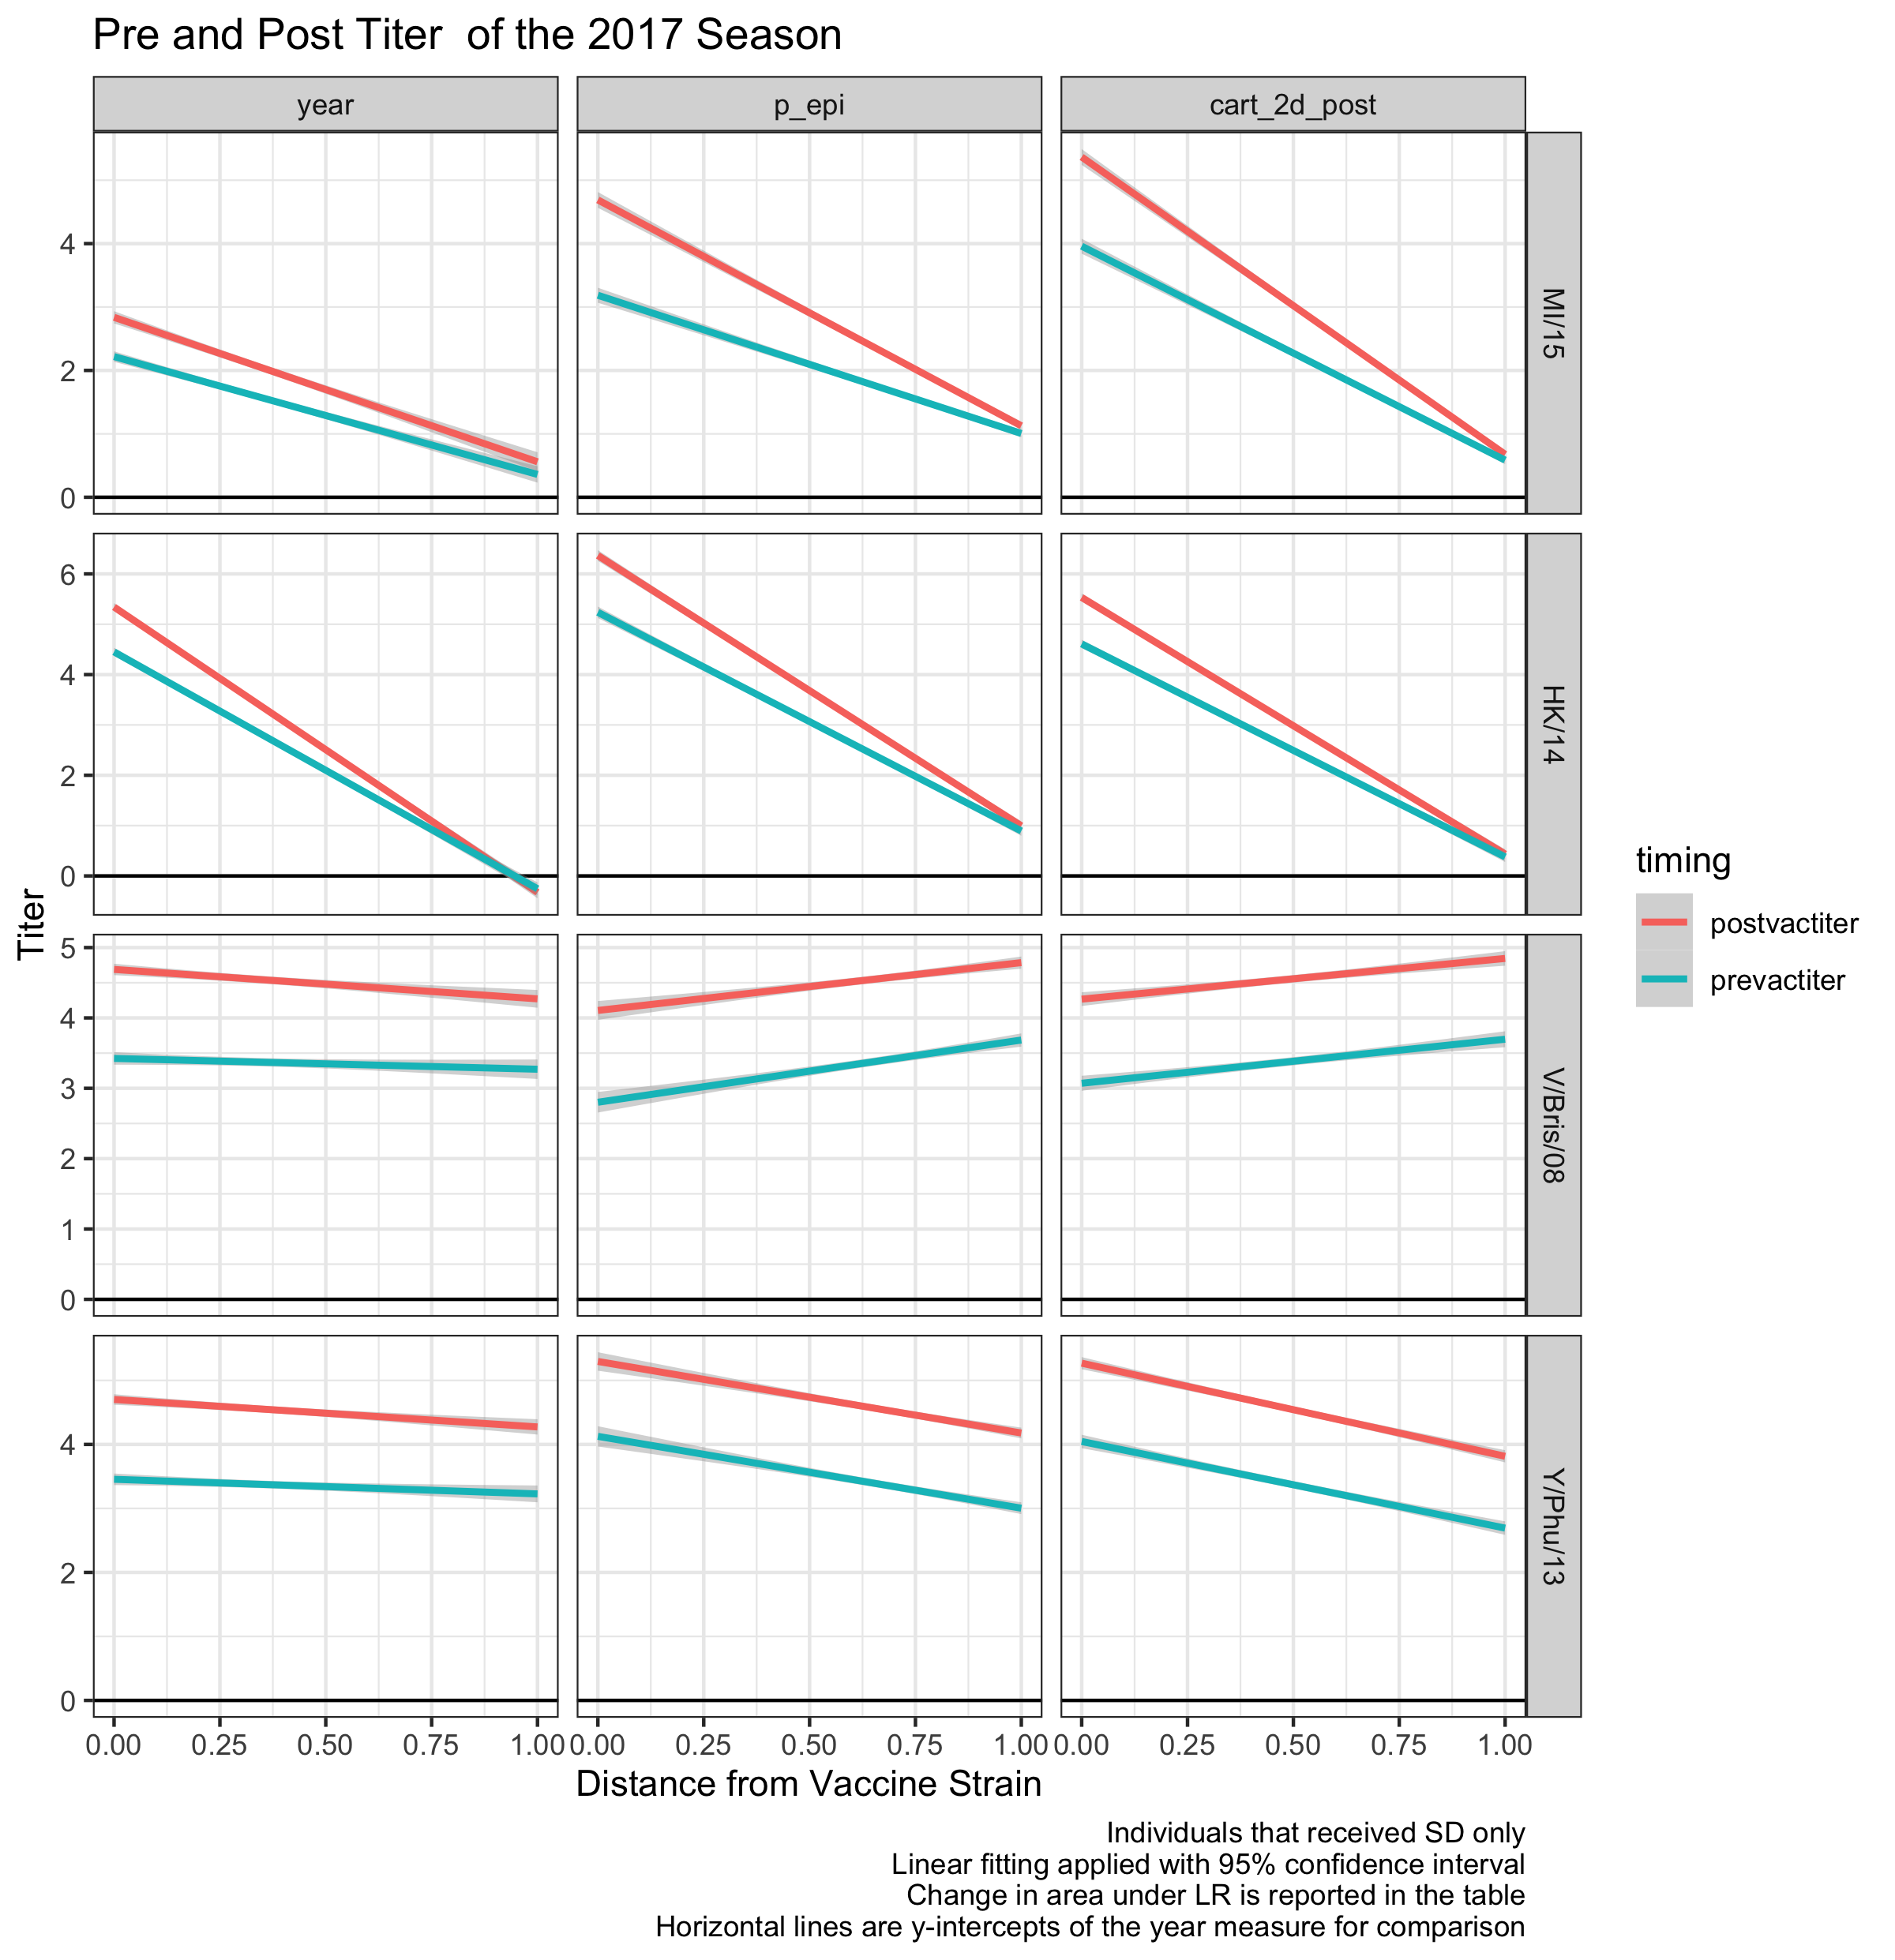
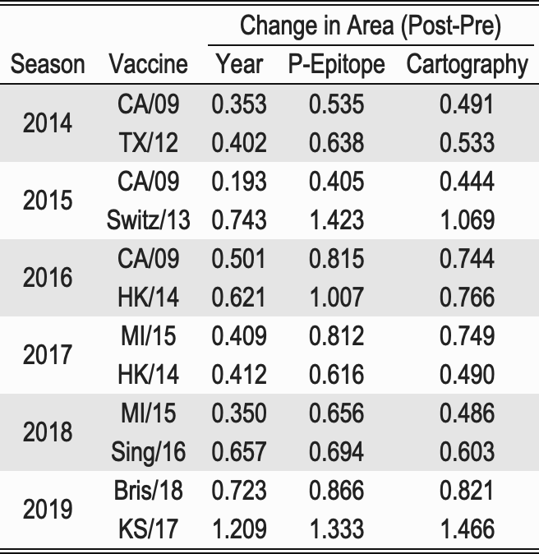
Comparing measures of SD recipients
P-epitope and cartography have greater or equal areas post vaccination compared to year measure
Notes:
Does not take into account individual variation;
Difference in areas under the linear regressions

Slide 22
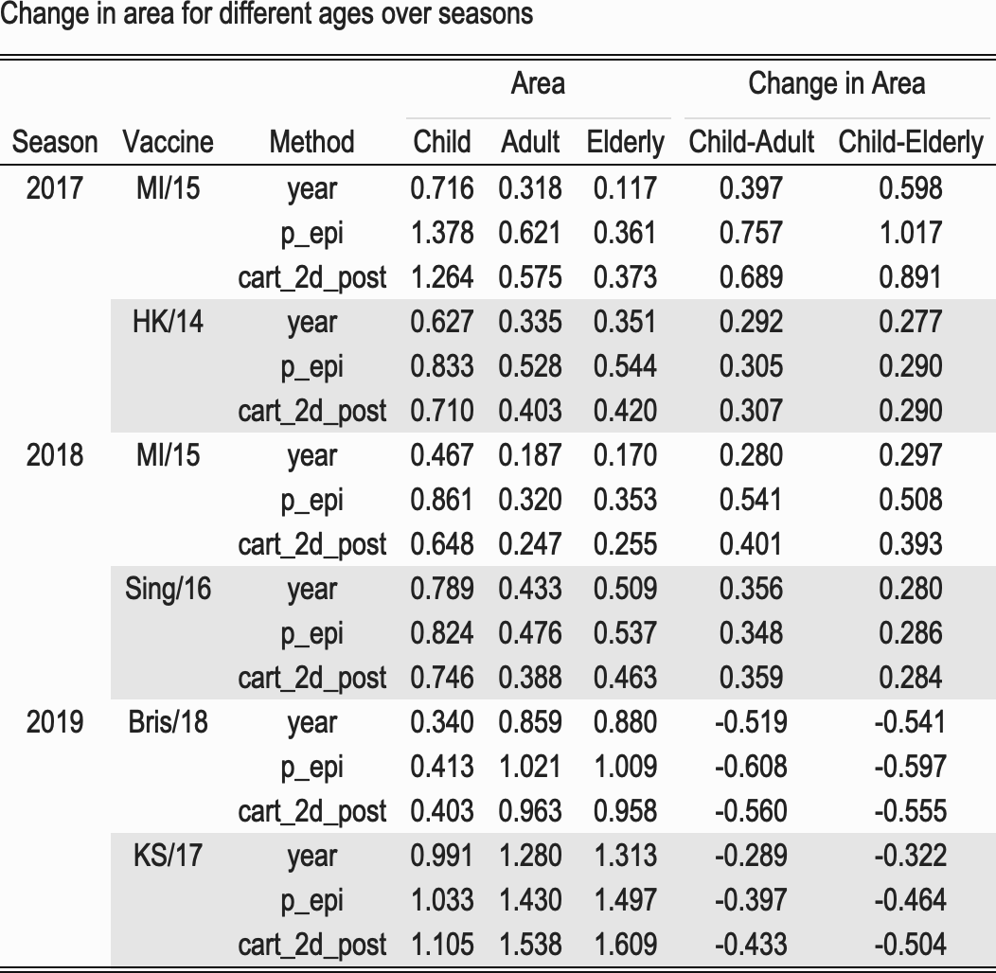
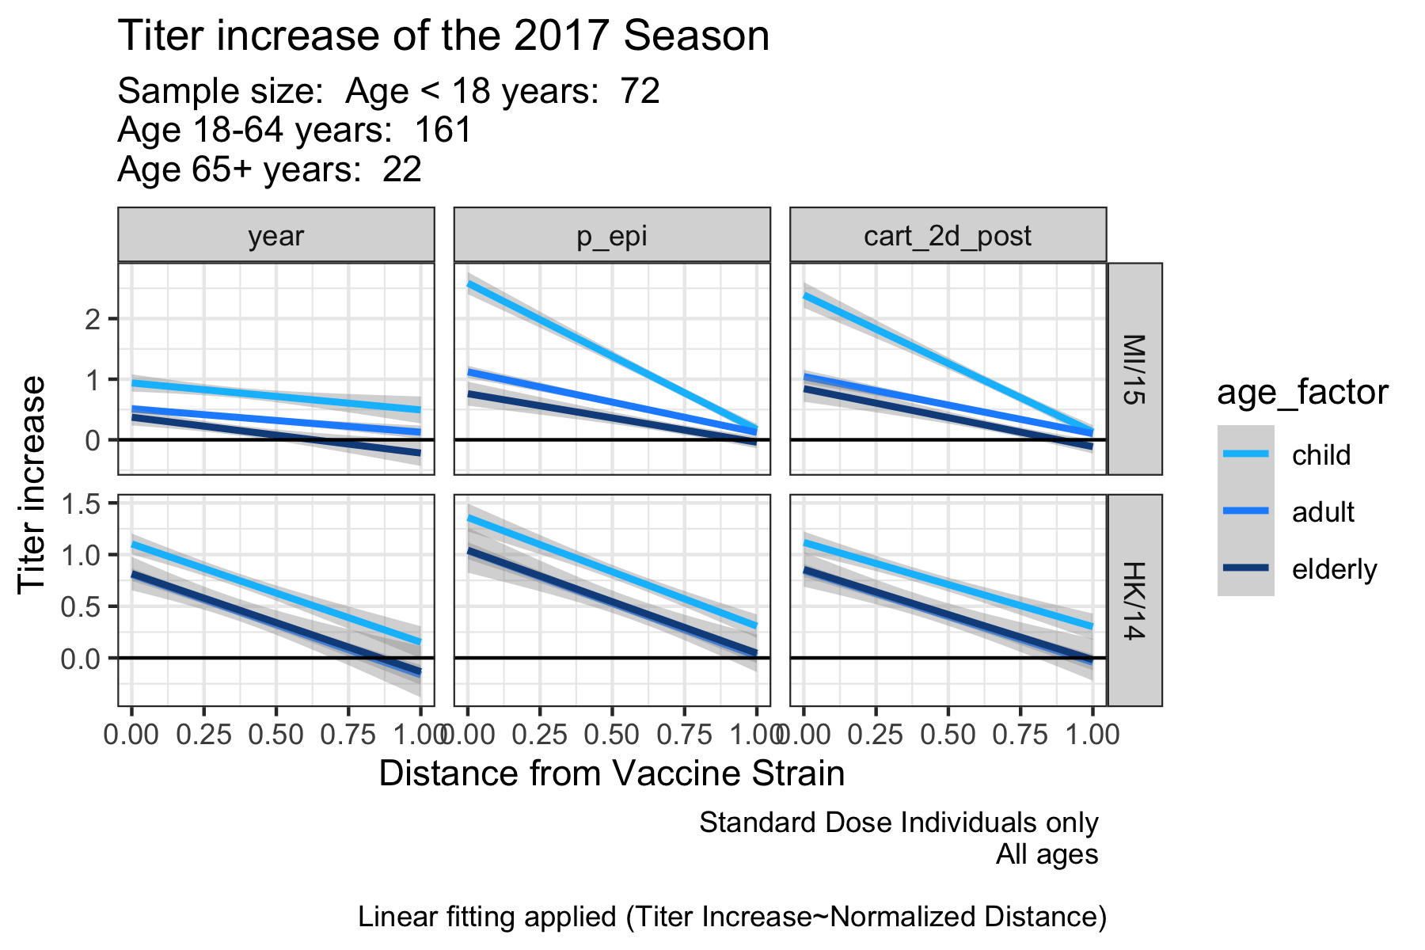
Comparison of Titer Increases
Notes:
Titer increases are similar to the pre-post calculations

Slide 23
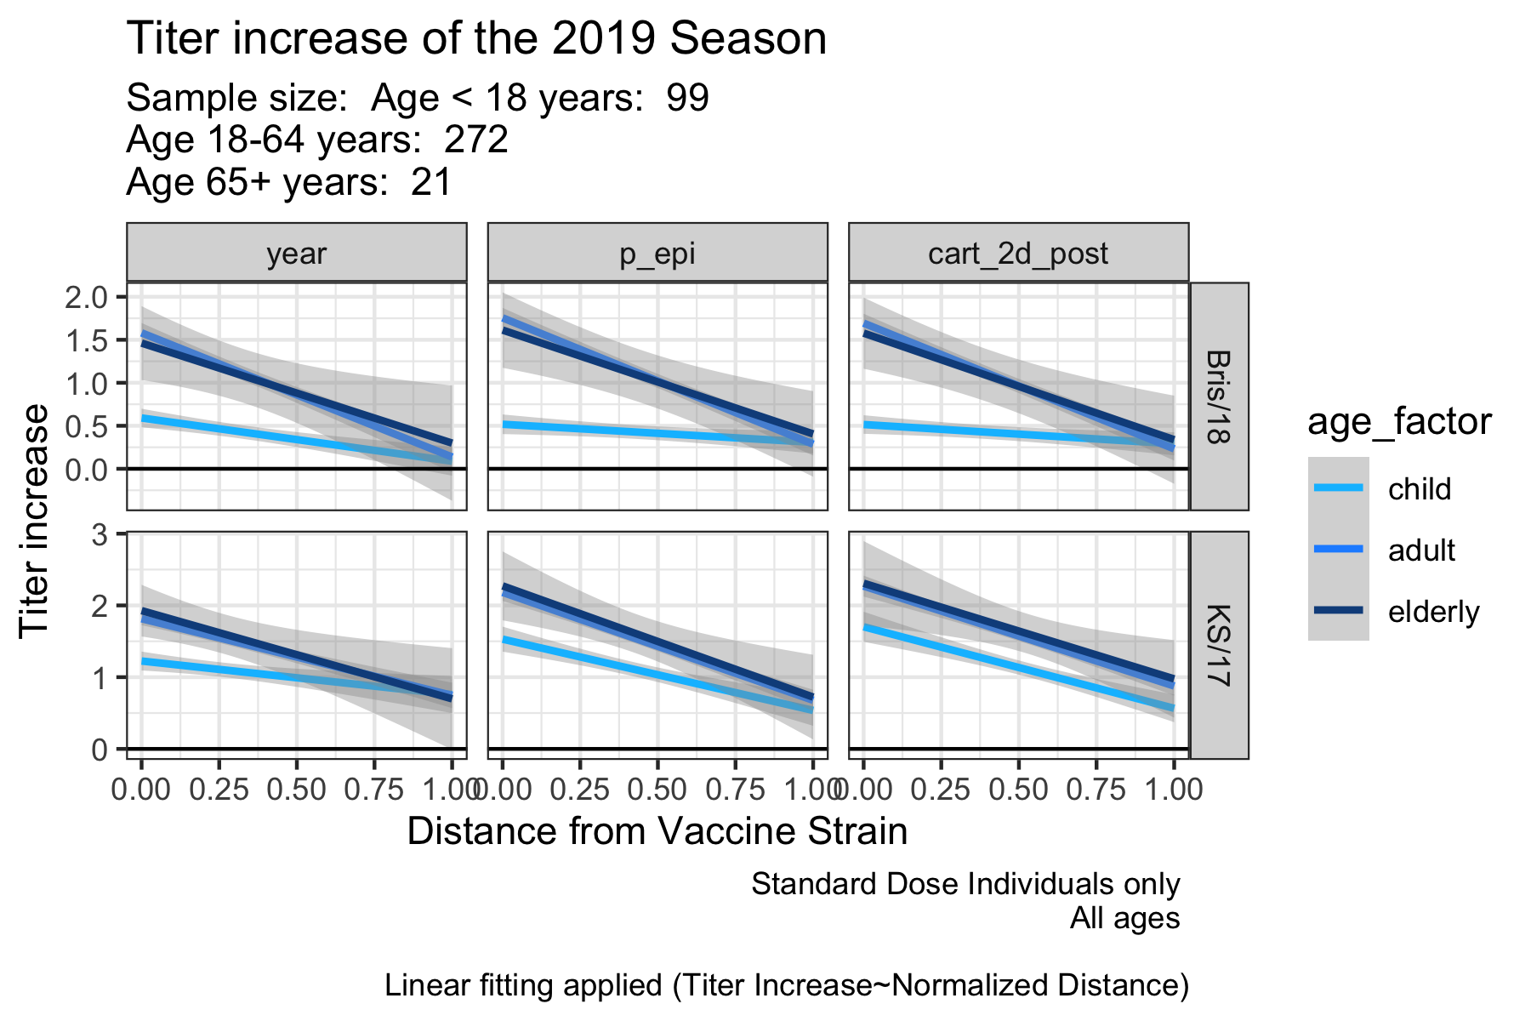
Titer Increases of 2019 Season
In the 2019 season there is a switch between child vs adult/elderly

Slide 24
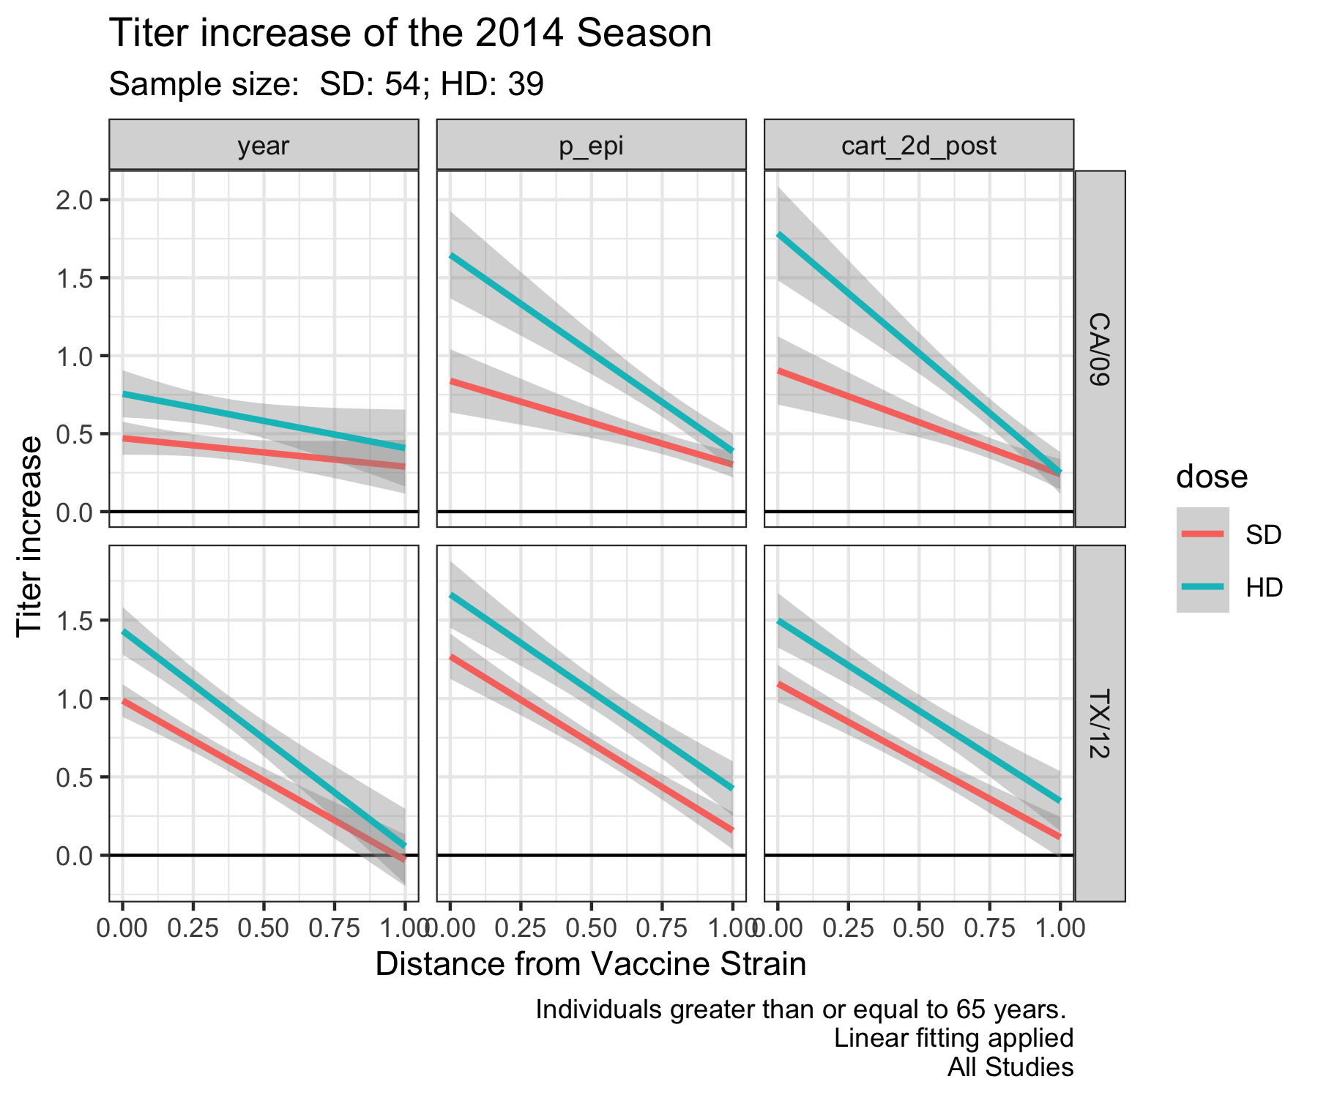
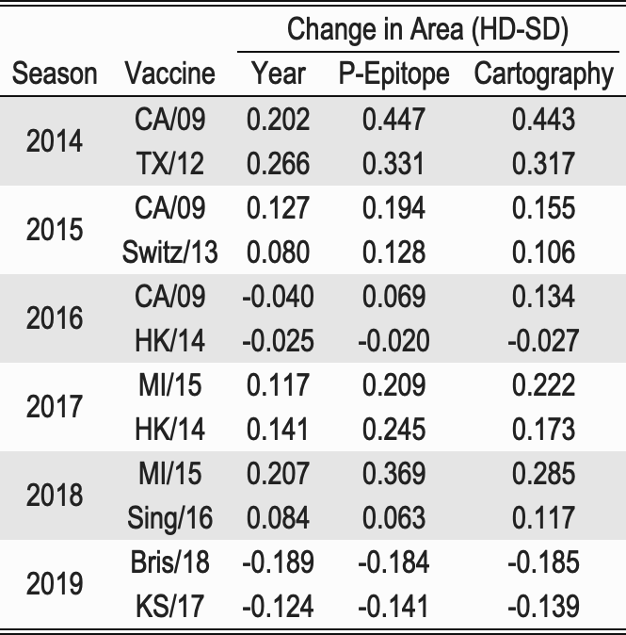
Titer Increase SD VS HD has similar results

Slide 25
Conclusions and Next steps
Estimation of breadth of the response:
Area under linear regression
Ignores individuals
Area under individual landscapes
Jagged
P-epitope is multivalued for any given x value
Type B vaccines have cross-reactivity across lineages
Next steps:
Add weighting penalizing for distance

Slide 26
Extra slides

Slide 27
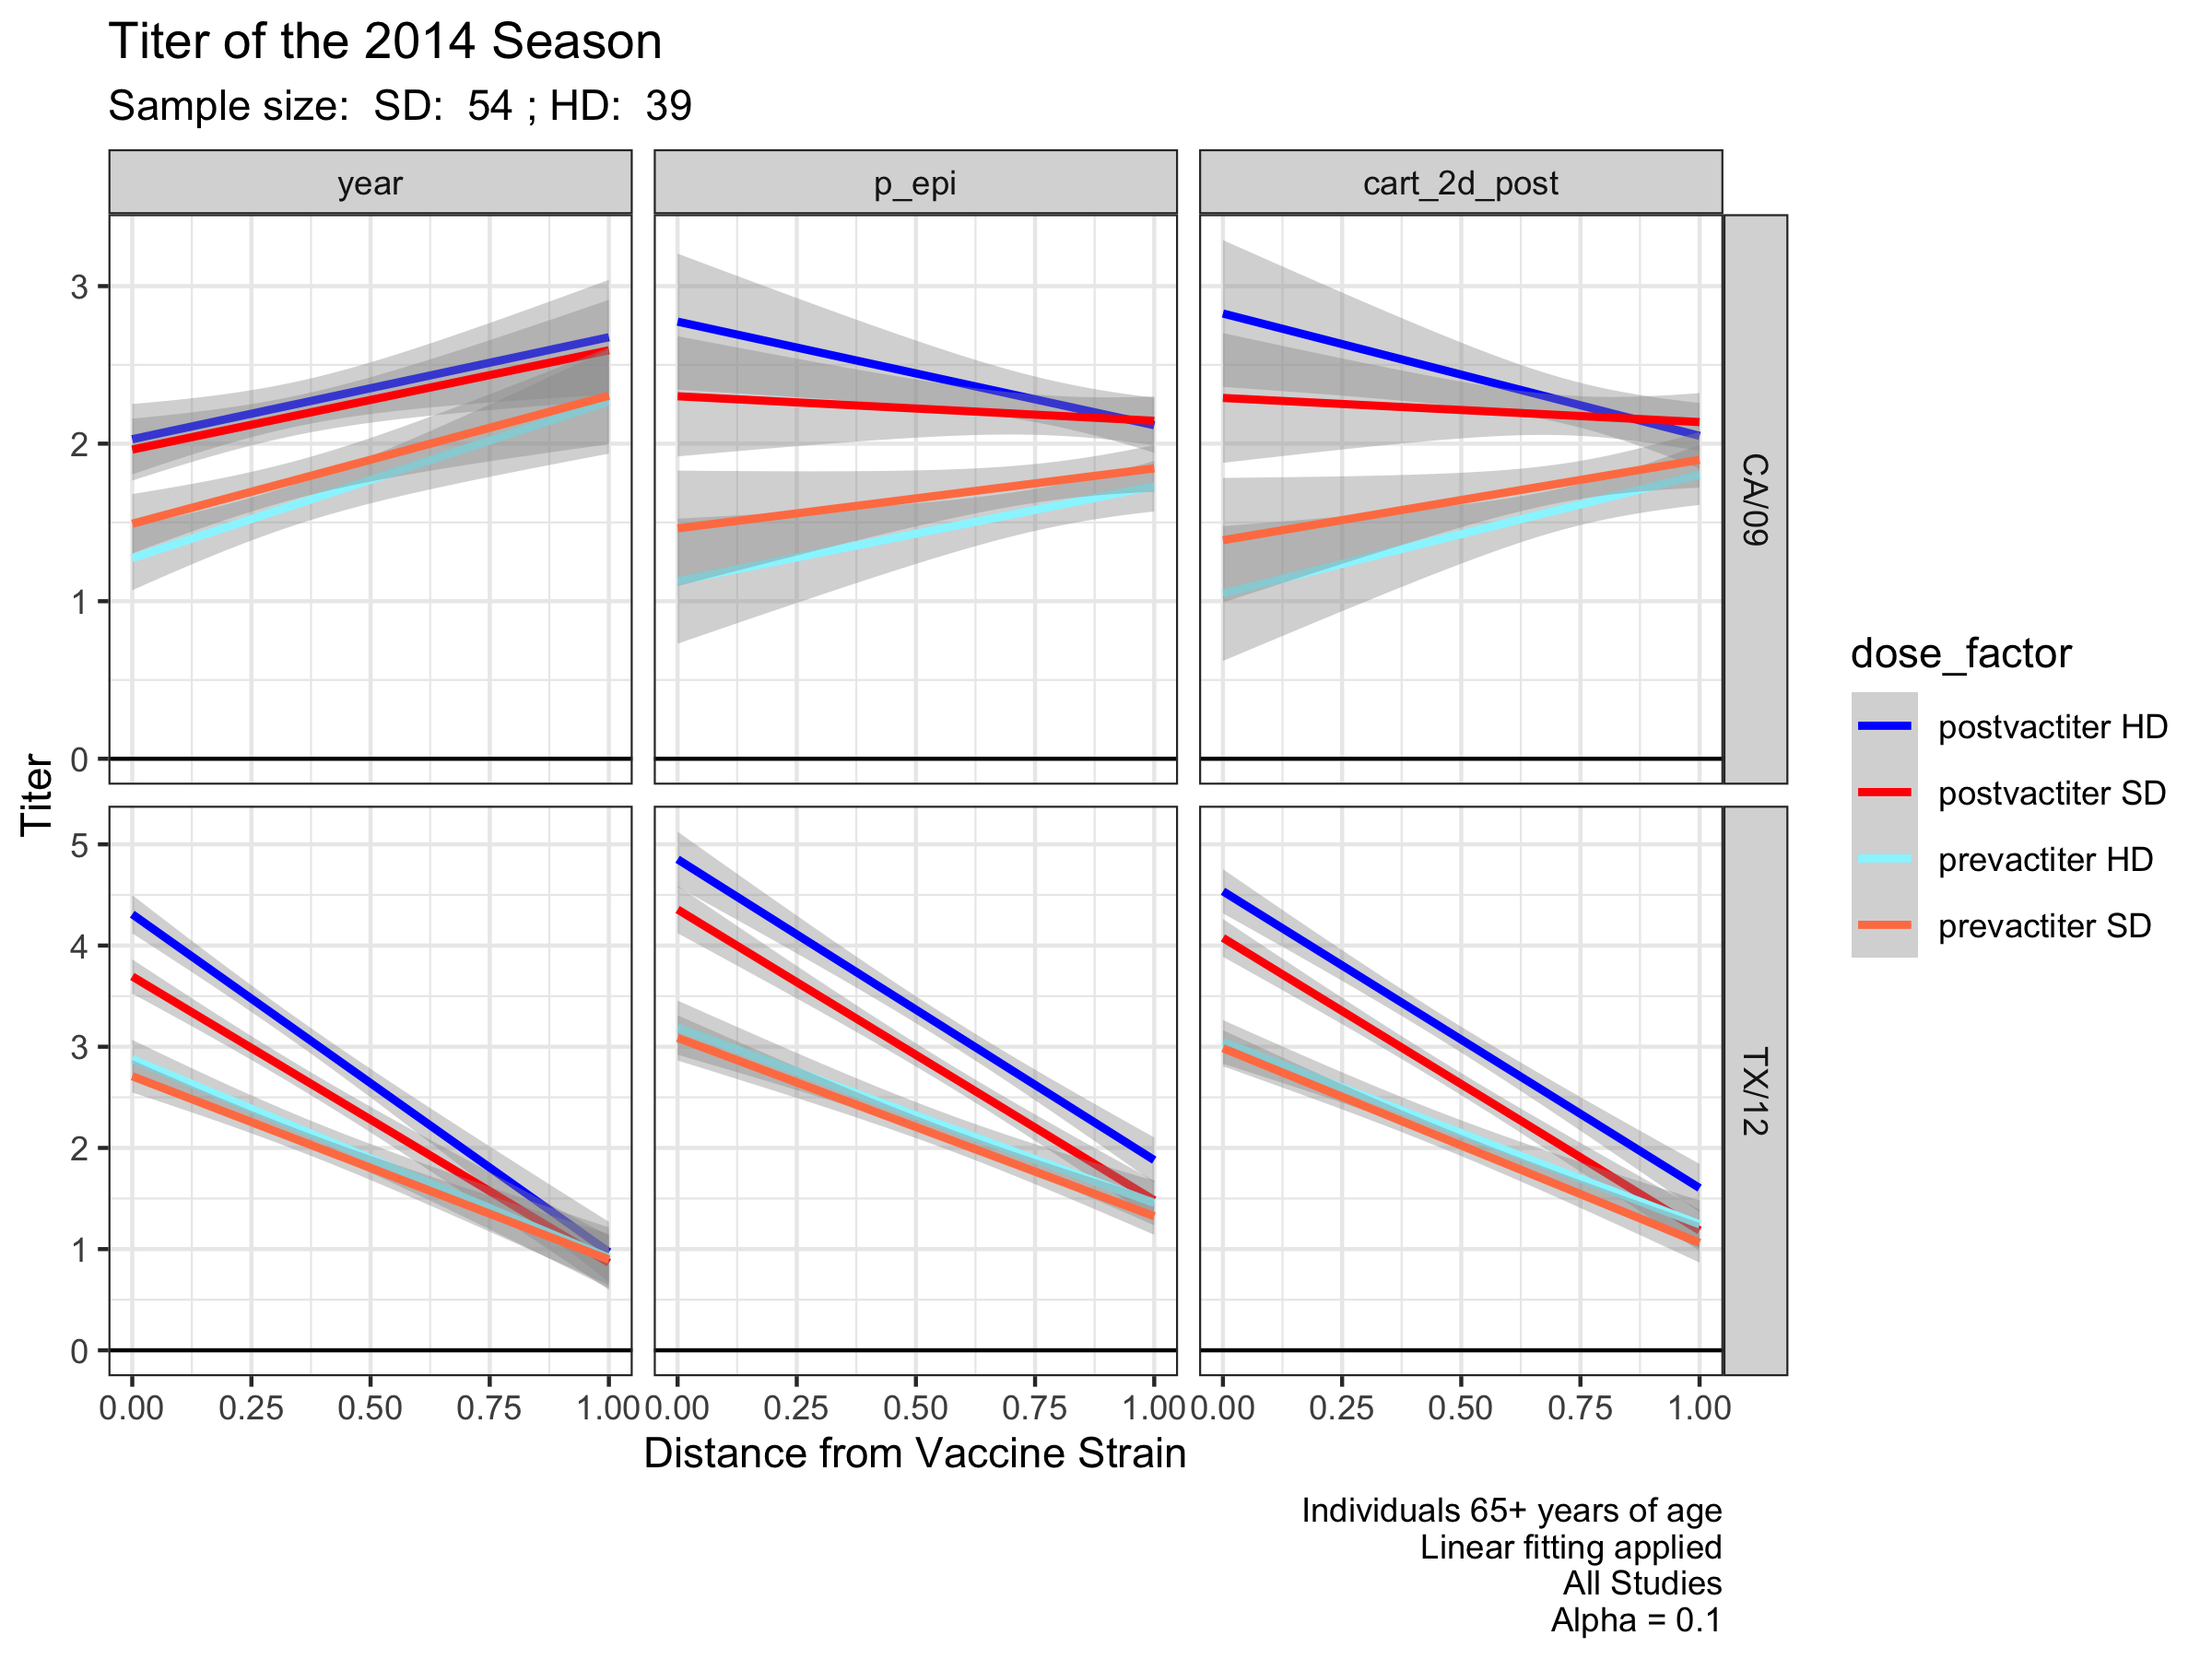
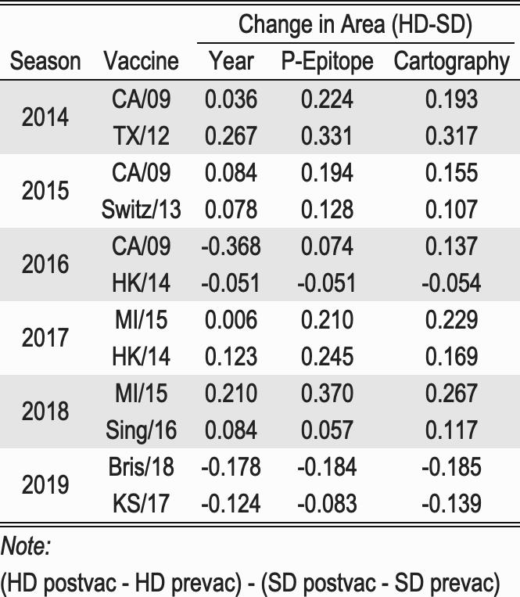
Pre/Post Titers SD VS HD

Slide 28
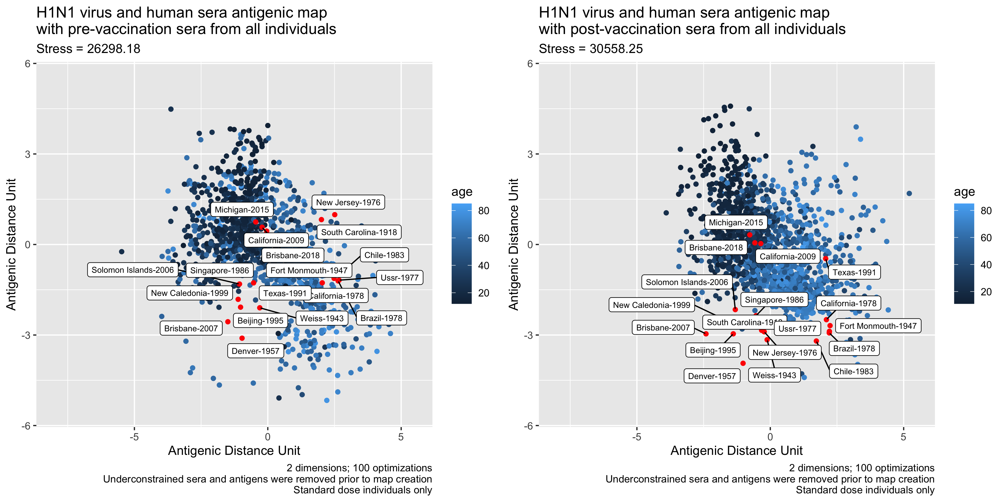

Slide 29
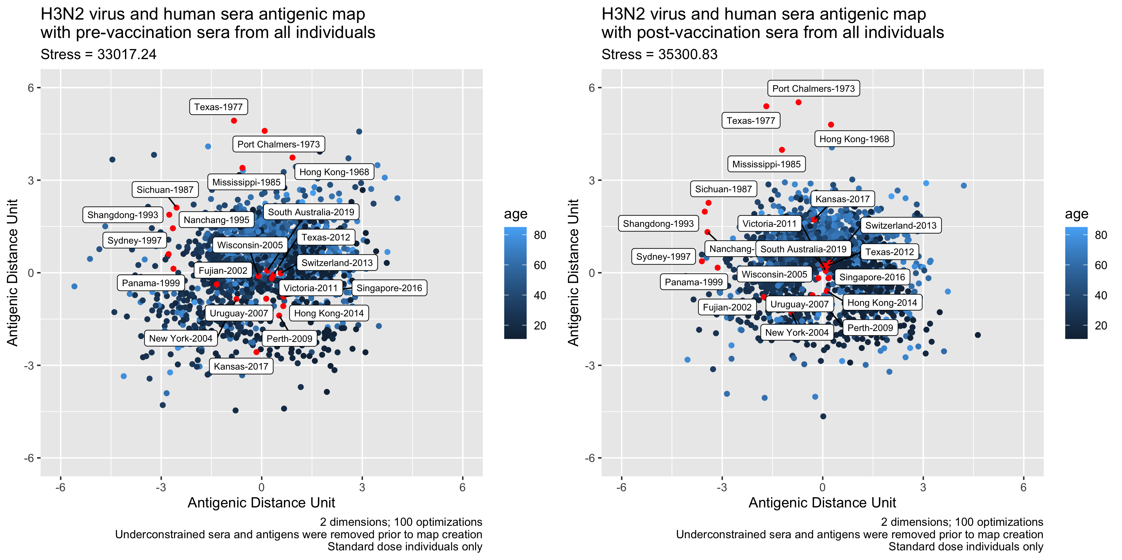

Slide 30
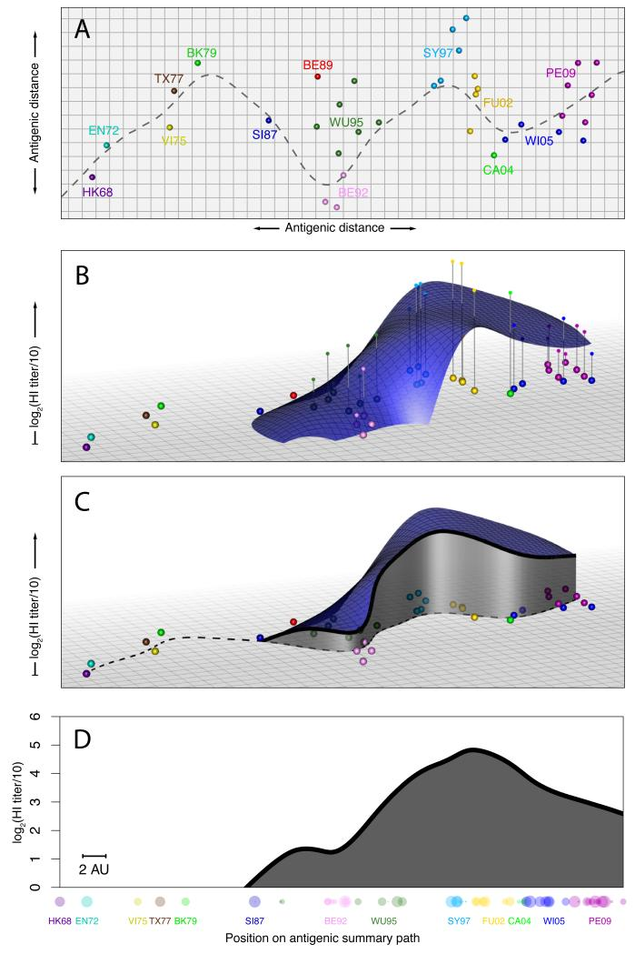
Landscapes include antigenic distance information
Goal: Visualize individual’s breadth to antigenic history
Antigenic cartography
Summary path using time of isolation
Use the individual’s serum titers to the viruses in the Z-axis. Fit locally-weighted multiple linear regression surface
Follow the summary path
Reduce to 2 dimensions
Fonville JM, Wilks SH, James SL, et al. Antibody landscapes after influenza virus infection or vaccination. Science. 2014;346(6212):996-1000. doi:10.1126/science.1256427

Slide 31
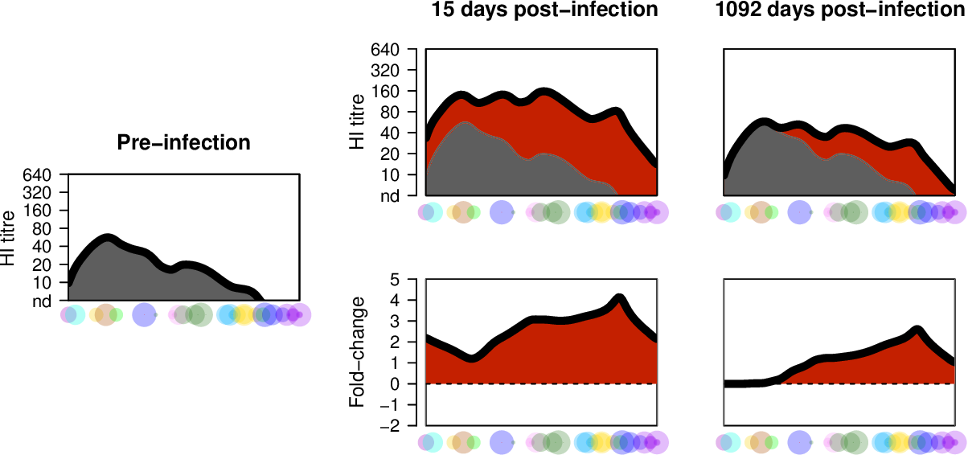
Antigenic Landscape profiles
X-axis is the antigenic distance from the cartography results
Reference point usually starts at 1968 virus
Antigenically related viruses are have shorter distances
Strain-specific responses will be steep peaks
Broadly-reactive will be hills
Previously used to look at:
Back-boosting
Predicting infection history
Breadth of IgG responses
An individual’s antibody profile
Wilks, S. (2017). Visualisation and analysis of patterns in serological data using "antibody landscapes". PhD Disseration. UK

Slide 32
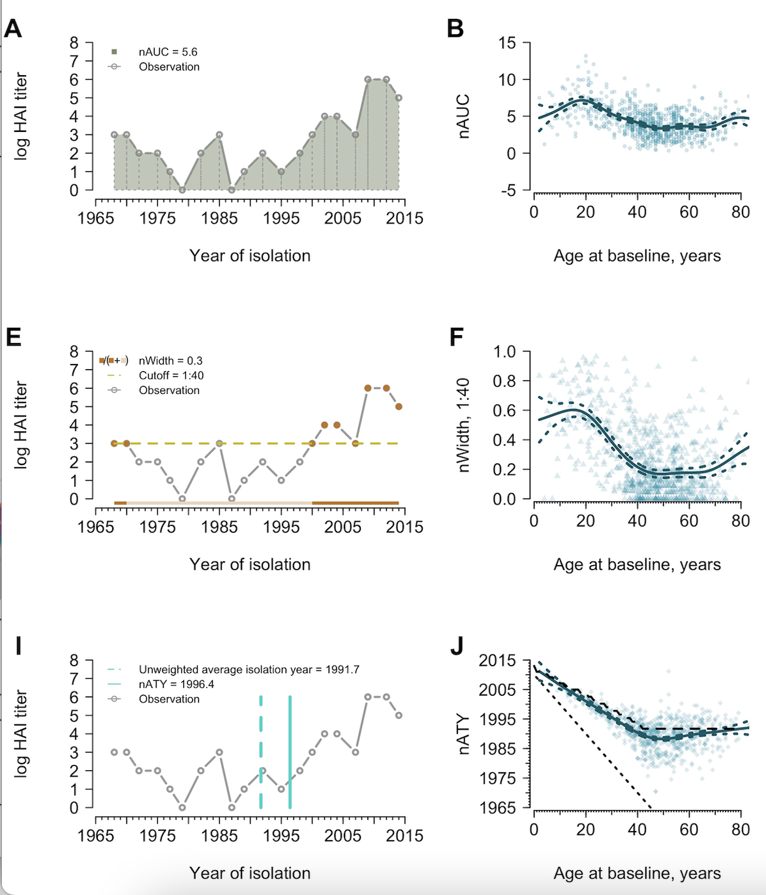
Metrics of Antibody Profiles
Area under the curve
Exclusion of pre-birth strains
Proportion out of 1
Threshold decided by researcher
1:40 used for protection
1:10 used for detection
Proportion of time above threshold
How immunity to strains circulating at different times contributes to the overall immune profile
Childhood biased: year is closer to birth year
Equally biased: year is half the age of the individual
Average Titer year
Yang B, Lessler J, Zhu H, Jiang CQ, Read JM, Hay JA, et al. (2020) Life course exposures continually shape antibody profiles and risk of seroconversion to influenza. PLoS Pathog 16(7): e1008635. https://doi.org/10.1371/journal.ppat.1008635

Slide 33
Summary
Representative Panel and count the response
Antigenic Landscape by strain
HAI titer VS the strain (categorical)
Antigenic Landscape by year
HAI titer VS the year of virus isolation (continuous)
Antigenic Landscape by Antigenic Distance
HAI titer VS the distance from the beginning of a summary path
HAI titer VS the distance from specified starting point
Quantification:
Area under the curve, change in profiles, width of the time frame, average titer year
Increasing in Information

Slide 34
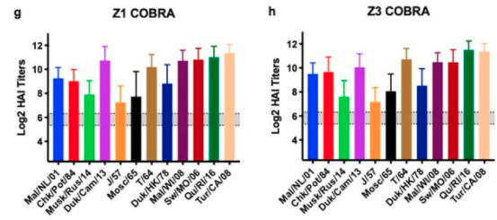
Overall: Antigenic Distances
Antigenic distances can be calculated using different assays
Most commonly HAI
Antigenic landscapes incorporate the difference between tested strains and the magnitude of the antibody response
Potential to include multiple assay results
Visualization of high dimensional date
Which vaccine performed better?
Reneer, et. al. 2020. Computationally Optimized Broadly Reactive H2 HA Influenza Vaccines Elicited Broadly Cross-Reactive Antibodies and Protected Mice from Viral Challenges. 10.1128/JVI.01526-20

Slide 35
Discussion
Quantification of breadth would allow for rigorous vaccine selection
Defining thresholds and values for selection instead of guessing which vaccine to move to the next stage
Weighting can be added
If it’s more advantageous for the vaccine to protect against human H1N1 instead of swine H1N1, then the selection criteria can be adjusted
Inclusion of different assays
Comparison of different research groups results
Antigenic distances allows for comparison of groups that are using different viruses
Bris/18 and MI/15 have similar distances but are three years apart

Slide 36
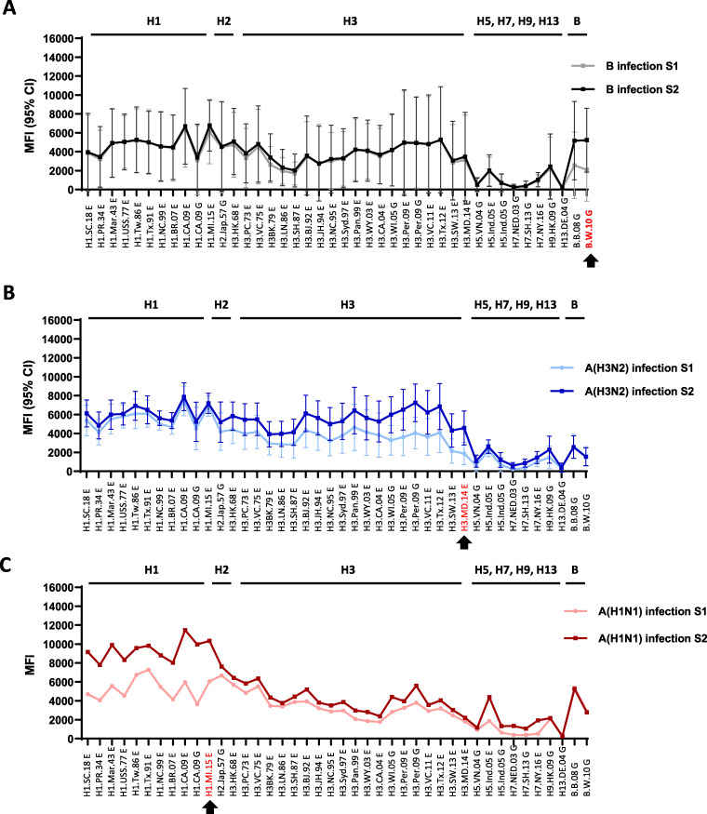
Antigenic Landscapes without Distances
Using multiplex influenza antibody detection assay
Pre and post vaccination with IIV
Acute (S1) and Convalescent Sera (S2) after Influenza B, H3N2 or H1N1 infection
Li, Z. N., Liu, F., Gross, F. L., Kim, L., Ferdinands, J., Carney, P., Chang, J., Stevens, J., Tumpey, T., & Levine, M. Z. (2021). Antibody Landscape Analysis following Influenza Vaccination and Natural Infection in Humans with a High-Throughput Multiplex Influenza Antibody Detection Assay. mBio, 12(1), e02808-20. https://doi.org/10.1128/mBio.02808-20

Slide 37
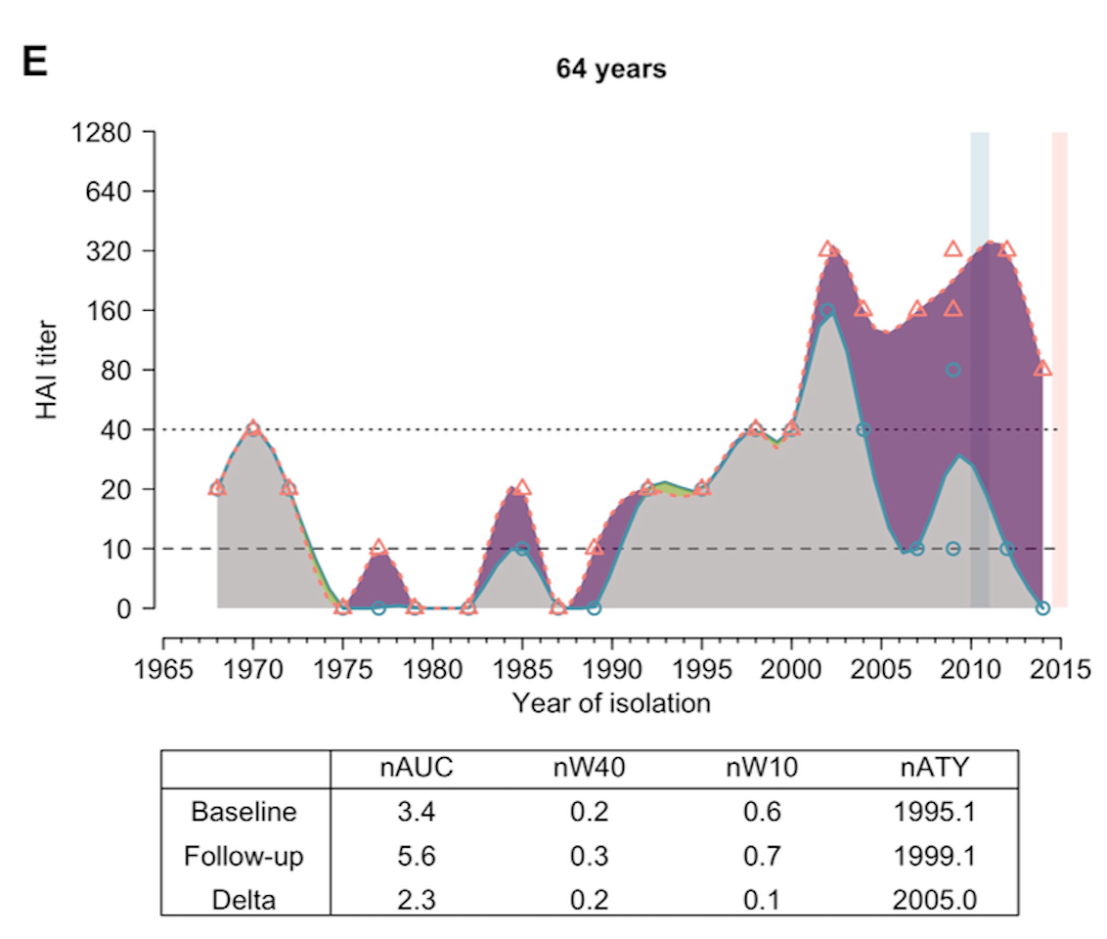
Antigenic Landscapes without Distances
Fluscape cohort
Age: 2-86 years
H3N2 testing
Used to study antibody profiles
Yang B, Lessler J, Zhu H, Jiang CQ, Read JM, Hay JA, et al. (2020) Life course exposures continually shape antibody profiles and risk of seroconversion to influenza. PLoS Pathog 16(7): e1008635. https://doi.org/10.1371/journal.ppat.1008635

Slide 38
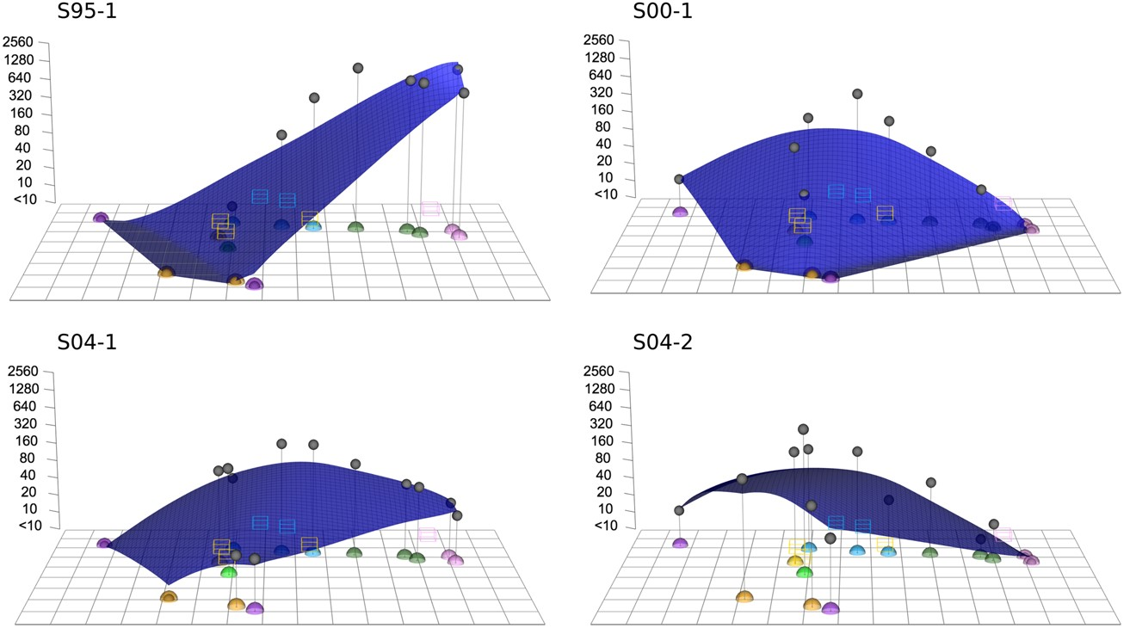
Antigenic Landscapes with Summary Path
Titer pattern of an individual's serum
Children 9-24 months
H3N2 landscapes
Compared naïve children to naïve ferret responses
Judith M. Fonville, Pieter L. A. Fraaij, Gerrie de Mutsert, Samuel H. Wilks, Ruud van Beek, Ron A. M. Fouchier, Guus F. Rimmelzwaan, Antigenic Maps of Influenza A(H3N2) Produced With Human Antisera Obtained After Primary Infection, The Journal of Infectious Diseases, Volume 213, Issue 1, 1 January 2016, Pages 31–38, https://doi.org/10.1093/infdis/jiv367

Slide 39
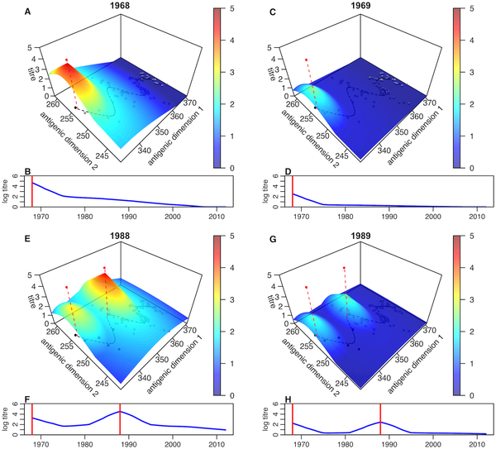
Antigenic Landscapes with Summary Path
Short and long term Antibody Dynamics
Longitudinal Human cohort from Vietnam
Visualization of backboosting
H3N2 cartography
Identified specific years with a high probability of infection
Kucharski AJ, Lessler J, Cummings DAT, Riley S (2018) Timescales of influenza A/H3N2 antibody dynamics. PLOS Biology 16(8): e2004974. https://doi.org/10.1371/journal.pbio.2004974
https://journals.plos.org/plosbiology/article?id=10.1371/journal.pbio.2004974

Slide 40
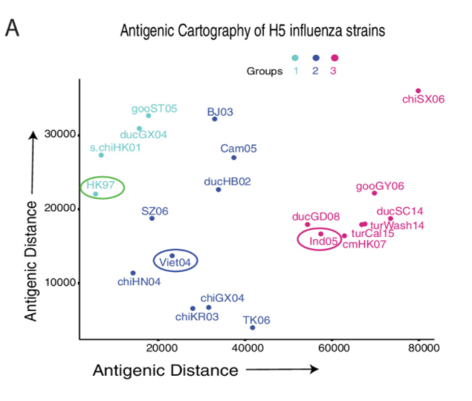
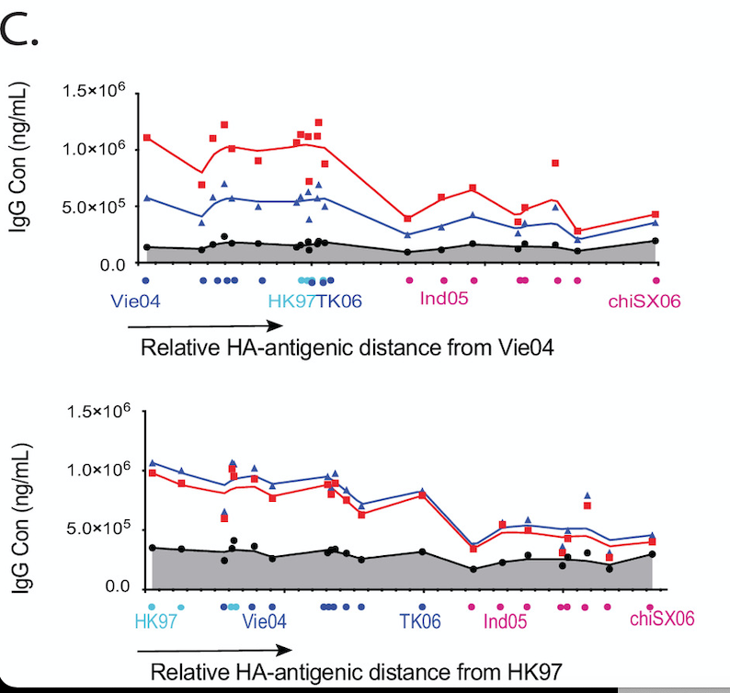
Antibody Landscapes with Relative Distance
Relative Antibody Landscape
Antigenic distance between the vaccine influenza strain and other H5 strains
Unclear if distance along a summary path or the Euclidean distance
mPlex-Flu assay
H5N1
Wang J, Li D, Perry S, Hilchey SP, Wiltse A, Treanor JJ, Sangster MY, Zand MS. Broadly Reactive IgG Responses to Heterologous H5 Prime-Boost Influenza Vaccination Are Shaped by Antigenic Relatedness to Priming Strains. mBio. 2021 Aug 31;12(4):e0044921. doi: 10.1128/mBio.00449-21. Epub 2021 Jul 6. PMID: 34225490; PMCID: PMC8406322.

Slide 41
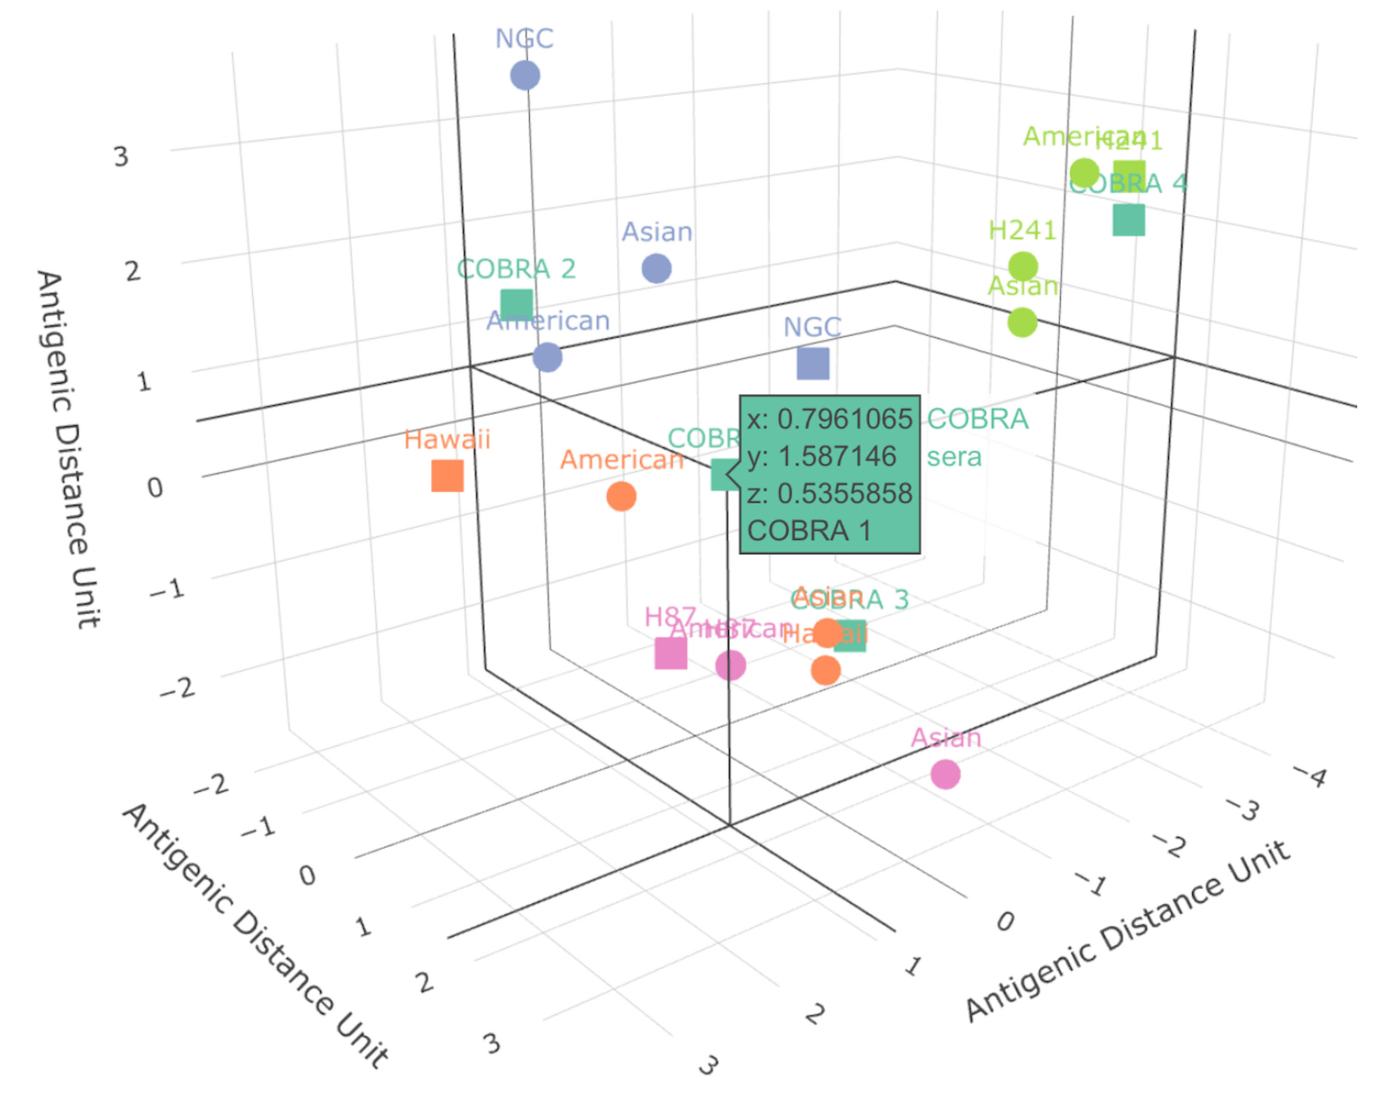
How can antigenic cartography used for breadth?

